Slide 1
Faceoffs 2022 NFHS Boys Lacrosse Rules
Notes:
This and crease play are THE MOST important things we do as officials: goals win gams, possession are opportunities for goals.

Slide 2
Agenda
The crosse
Positioning
Administering
Game play
Fouls
Mechanic
Faceoff scenarios (man up, out of bounce, restarts, etc.)
Notes:
The faceoff is a critical part of lacrosse, more possessions = more scoring opportunities.
It is one of the few times on the lacrosse field we as officials know what is about to happen,
Some rules and exceptions ONLT apply to faceoffs,

Slide 3
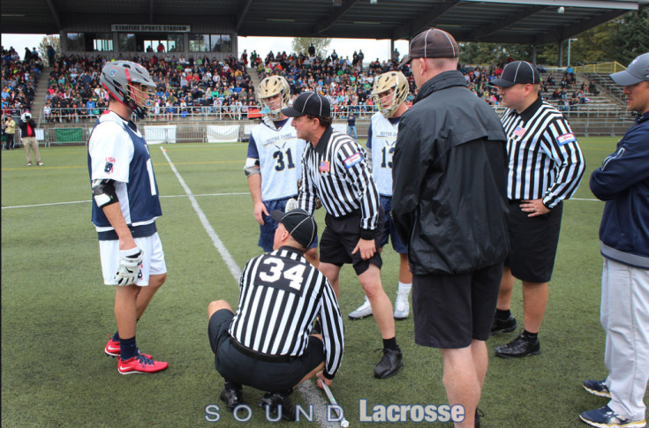
Notes:
Pre-Game Meeting is ESSENTIAL given all the new rules; communication not violation. ESPECIALLY with youth players and newer programs. Explain and Demonstrate.
FO is a critical part of the game and we actually know what we want and what will likely happen.
Possessions = scoring opportunities.

Slide 4
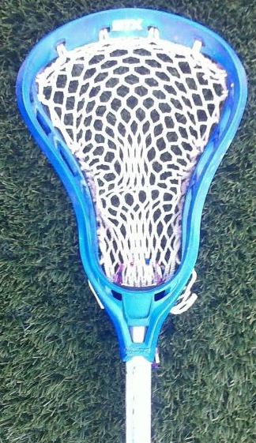
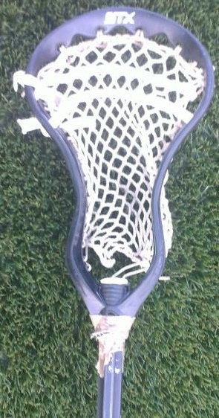
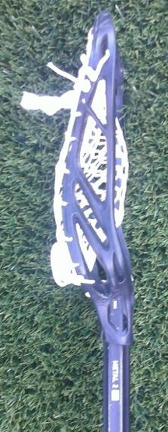
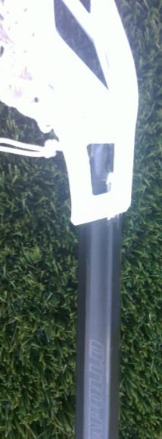
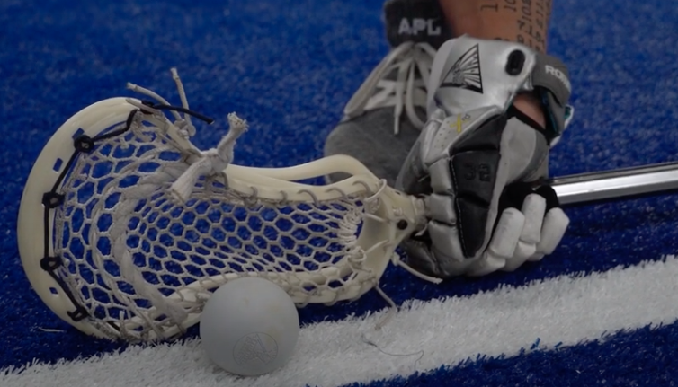
FOGO Crosse
Circumference of the shaft shall not exceed 3.5 inches.
Contrasting color between the head and the top glove must be visible on the shaft during faceoffs.
No tape on plastic.
DELAY
Rule 4.3.3n
Notes:
This is only for crosses taking a faceoff…..
original shaft color
paint
single wrap of tape, but not on plastic
other material
Left to right:
Image 1: Tape on the head of the crosse, should be discovered in the pre-game discussion with faceoff players. Tell an offending player to remove the tape before the game.
Image 2: Black head with a black crosse – does not contrast, illegal for use on a faceoff.
Image 3: Blue head with a white crosse – contrasting color, legal for use on a faceoff.
Image 4: White head with a black crosse – contrasting color, legal for use on a faceoff.
Rule 4-3- 3 previously called for tape to be applied to the handle of the crosse for any player taking a faceoff. With new handle materials now available that are more durable than tape, the committee revised the rule to allow for use of new materials.
Don’t be too good.
Rule 4-3-3 n now specifically states the circumference of the shaft shall not exceed 3.5 inches, and a contrasting color between the head and the top glove must be visible on the shaft during faceoffs with the original shaft color, paint, a single wrap of tape, or other material.

Slide 5
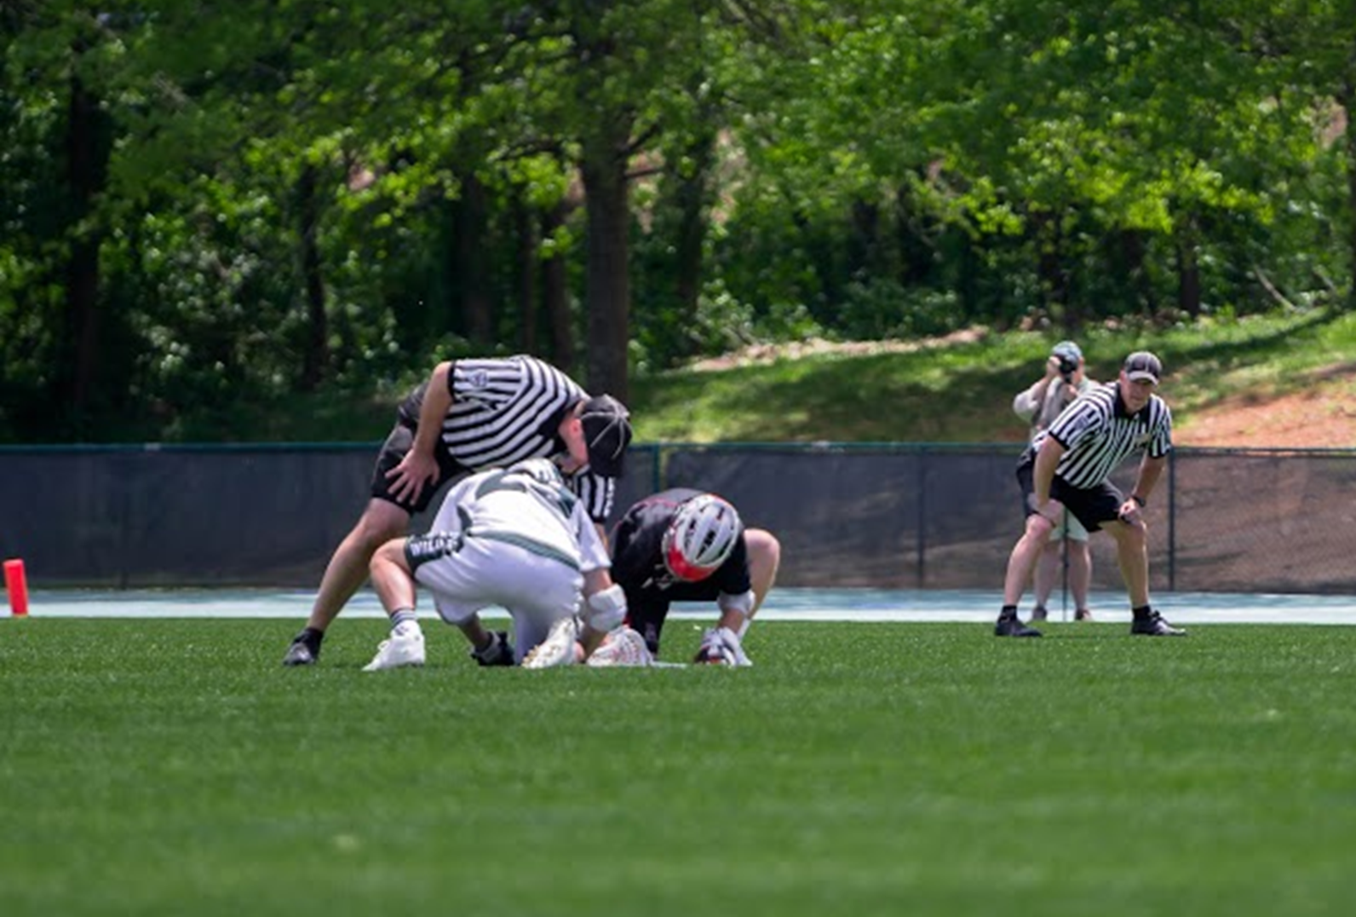
Notes:
This is a MAJOR part of the game that we influence possession = opportunities to score
The entire crew must work together

Slide 6
LL
FO
W
Position of Players on a Faceoff
Notes:
RUNNING LEFT Goalkeeper and 3 defensive players behind Defensive Area Line, 1 player in each wing area, 3 behind opponent’s Defensive Area Line.
Players facing off with back to goal they defend.

Slide 7
Administering a Face Off
4-3-3 a, b, c, f, g: ART. 3 . . .The official conducting the faceoff will start the procedure by placing the ball on the midfield line at the spot on which the faceoff will take place. a. The official shall instruct the players to prepare for the faceoff by saying "down." b. Once the players are down, they are to move into their faceoff position as quickly as possible. Players shall stand as they get into position for the faceoff and must remain standing until the whistle sounds to start play. c. The crosses and gloves shall rest on the ground along the center line, parallel to each other up to, but not touching, the center line. All fingers of both hands shall be gloved and wrapped around the crosse. The crosse head and the gloved hands shall be touching the ground. The hand closer to the throat shall be in a palm-up position. f. Once the players are in the proper position, the official shall ensure that the crosses are positioned such that the ball is in the middle of the head of each crosse. g. Once the official is satisfied with the positioning of the players' crosses, he shall instruct the players to remain motionless by saying "Set.". For hearing impaired players, a reasonable accommodation for the "set" command and whistle sound will be provided.
Rule 4:3 Art. 3
Notes:
If a player keeps coming down with his stick on the line or his hand on the plastic after repeated adjustments and verbal warnings by the official; the official may call a pre-whistle violation. Just because the officials may adjust players does not mean players get to come down illegal every time. The cleaner faceoff players get into position the less time they will spend crouched down being adjusted.

Slide 8
Game Play on Face Off (New)
4-3-3i (NEW): ART. 3 . . . Upon the whistle starting play, each player must attempt to play the ball first before they may body check their opponent. Other Rules Affected 5-3-3: ART. 3 . . . Body checking of an opponent who has any part of their body other than their feet on the ground or while crouched for a faceoff. Rationale: As a way to make the faceoff fair, safe, and result in fewer long stalemates this rule will ensure that faceoff players are playing the ball and not body checking or stick checking an opponent’s body.
Rule 4:3 Art. 3
Notes:
If a player keeps coming down with his stick on the line or his hand on the plastic after repeated adjustments and verbal warnings by the official; the official may call a pre-whistle violation. Just because the officials may adjust players does not mean players get to come down illegal every time. The cleaner faceoff players get into position the less time they will spend crouched down being adjusted.

Slide 9
Game Play on Face Off (Update)
4-4-2: ART. 2 . . . When the whistle sounds to start play, the players in the wing areas shall be released but must avoid body checking the faceoff players battling for control of the ball in the initial faceoff spot. All other players are confined to their areas until a player of either team has gained possession of the ball, the ball goes out of bounds, the ball crosses the defensive-area line, a whistle stops play for a time-serving foul, or whistle restarts play after a non-time-serving foul; when any of these events occur, the faceoff has ended. Players designated in the midfield area, and players designated within the defensive area may not interchange positions before possession have been called, and the faceoff has ended, but midfielders may substitute. Rationale: Avoids checks to faceoff players that are in a potentially vulnerable position. This rule is already not well understood by players and coaches, and this change will codify what is not allowed and help protect players taking a faceoff.
Rule 4:4 Art. 2
Notes:
If a player keeps coming down with his stick on the line or his hand on the plastic after repeated adjustments and verbal warnings by the official; the official may call a pre-whistle violation. Just because the officials may adjust players does not mean players get to come down illegal every time. The cleaner faceoff players get into position the less time they will spend crouched down being adjusted.

Slide 10
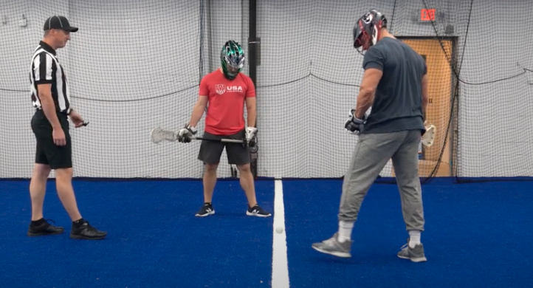
Down
Down
Notes:
Single: Down, adjust sticks.
LL: looks to make sure neutral zone is clean, sticks are parallel and on ground.
Single: places ball. Say “Set” quietly (no need to yell) with HAND ON STICKS. Backs away, blows whistle.
LL: should have most violations.

Slide 11
Tops to Stops
Rules 4-3-3 d
Notes:
Rules 4-3-3 d states that during faceoffs the reverse surfaces of crosses must match evenly so that the top of one head lines up with the throat of the other and they are perpendicular to the ground. GLOA trainers began to introduce this mechanic last spring. The expression “tip to stop” provides a good visual.
Rules 4-3-3 d states that during faceoffs the reverse surfaces of crosses must match evenly.

Slide 12
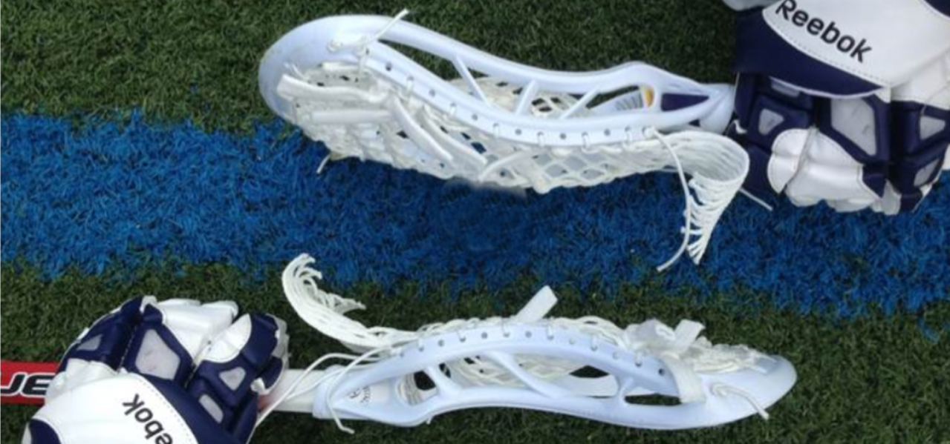
Incorrect Positioning
Rule 4:3 Art. 3-4
Notes:
All of these images show a different illegal face-off position. At lower levels of play it may be permissible to tell the players what to fix if they are lined up incorrectly. At higher levels of play you should not spend an excessive amount of time correcting the positioning. Stand the players up and turn the ball over to the opposing team. Inform the coach what the problem was if he asks at the next available opportunity.

Slide 13
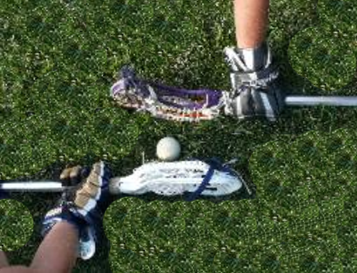
Neutral Zone
Formed by the heads of both crosses; extends out and up.
Body, hands and feet must be to the left of the head of the crosse.
May lean over the center line, but not over head of crosse.
Rule 4:3 Art. 3-4
Notes:
EXPLAIN THIS! MOST DO NOT KNOW
Face-off players must also:
Have their sticks parallel to the line and not touching the line
Sticks vertical and not leaning over the ball or line
Entire body to the left of the throat of their crosse
Helmet not leaning over the ball (may lean over the line)

Slide 14
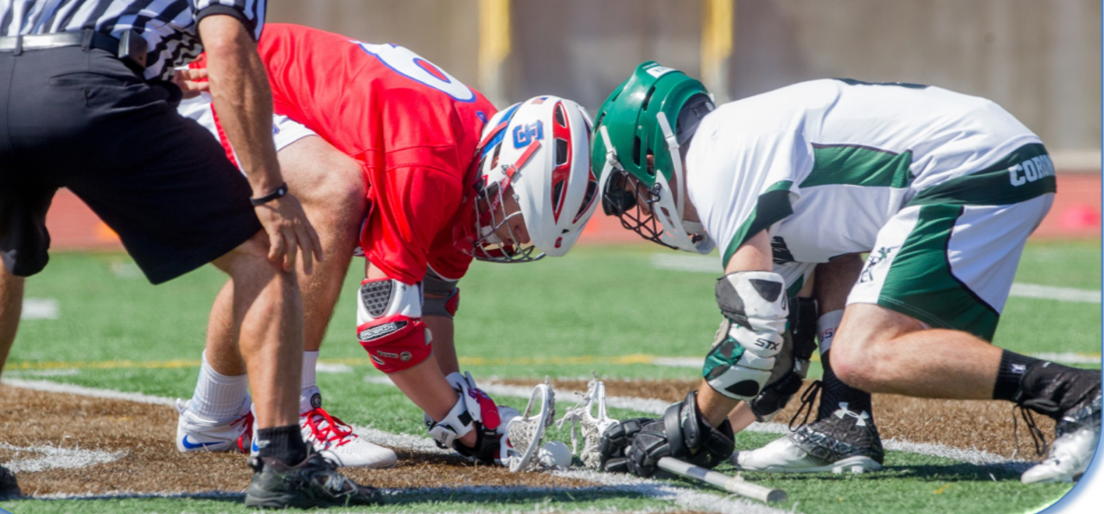
Perpendicular
Rule 4:3 Art. 3-4
Notes:
All of these images show a different illegal face-off position. At lower levels of play it may be permissible to tell the players what to fix if they are lined up incorrectly. At higher levels of play you should not spend an excessive amount of time correcting the positioning. Stand the players up and turn the ball over to the opposing team. Inform the coach what the problem was if he asks at the next available opportunity.
b

Slide 15
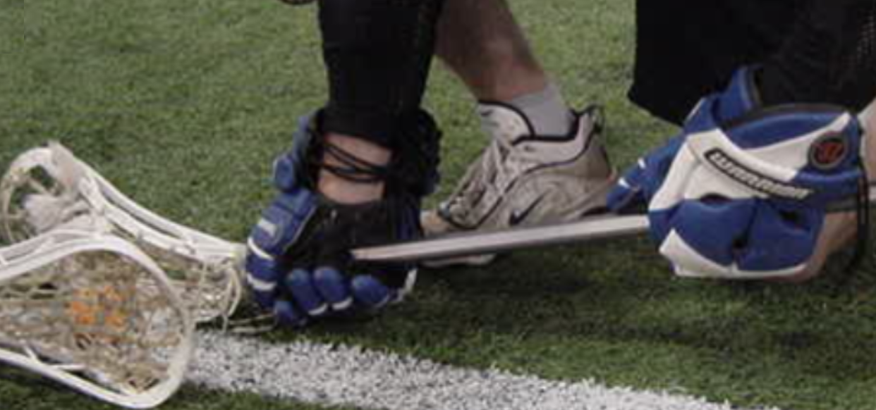
Hand Off Ground
Rule 4:3 Art. 4 d
Notes:
“Each player must have both hands wrapped around the handle of his own crosse, touching the ground. ”
Excerpt From: NFHS. “2018 NFHS Boys Lacrosse Rules Book.” iBooks. https://itunes.apple.com/us/book/2018-nfhs-boys-lacrosse-rules-book/id1316615151?mt=11
Hand off ground!

Slide 16
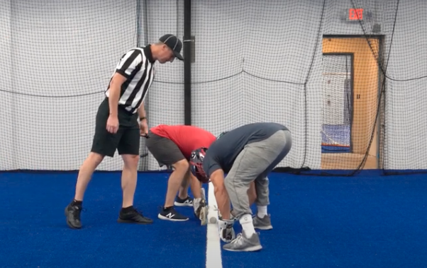
Check and Adjust
Notes:
Single: Down, adjust sticks.

Slide 17
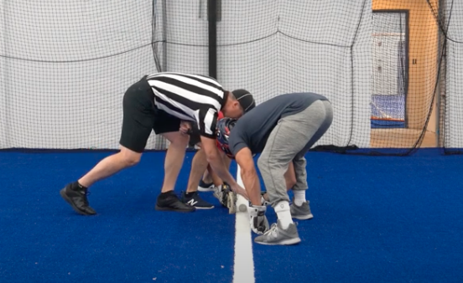
Set
Set
Notes:
Adjust sticks, place ball, set with hand on sticks. Back away.
Whistle has to be in mouth.

Slide 18
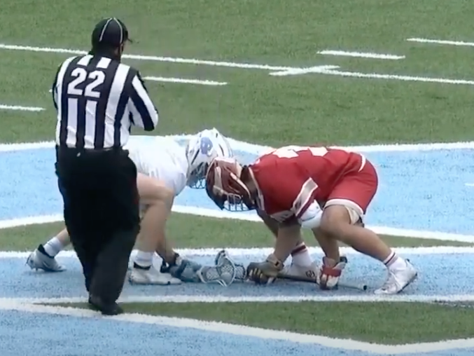
Whistle
Notes:
Back away slowly with whistle in mouth: blow whistle as you back out.
Officials must communicate – Do not be in a rush to start the face-off. Look to your partner on the wing line and make sure you are getting the “ready” signal. If you are the wing official and your partner is starting the face-off and the field is not set, get his attention and make sure the field is set properly.
Vary the whistle – The timing of the whistle should vary on each faceoff to prevent players from timing the whistle. One step, whistle, three steps whistle. Vary according to your judgment and ability to back out.

Slide 19
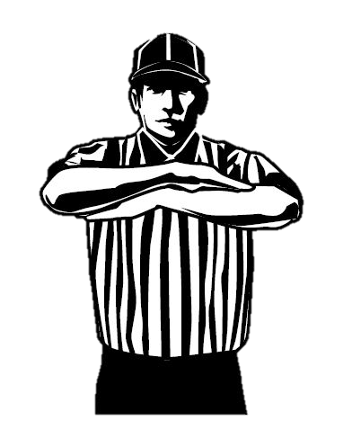
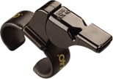
Delay of Game
Foul or delay before FO, or if player moves after “set;” award to offended team.
Do NOT blow whistle, ask players to stand and point.
Rule 4:3 Art 3-5
Notes:
Rule 4:3 Art 3-5
Be sure to communicate to partner and coach what happened.
MAKE A CALL!

Slide 20
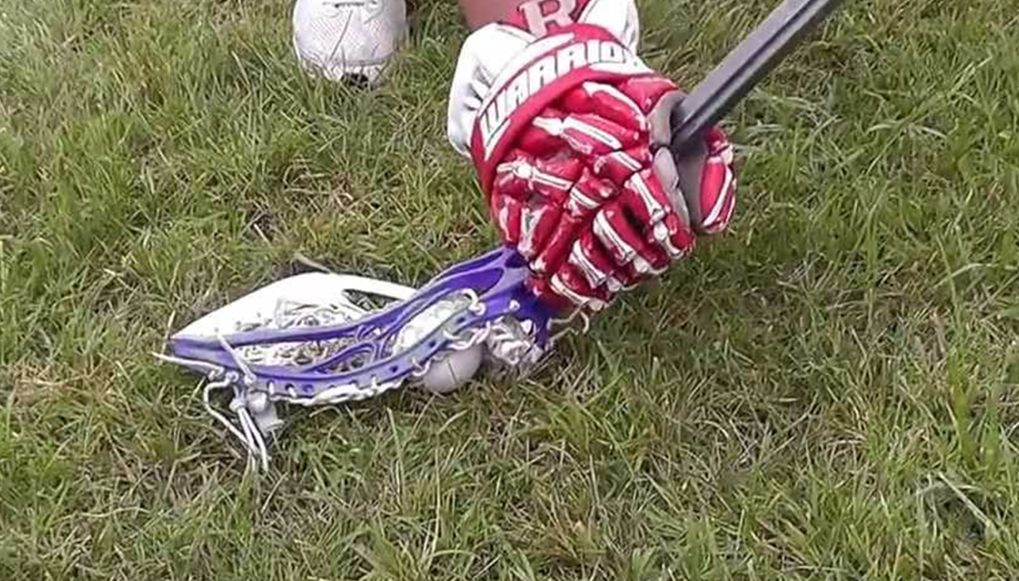
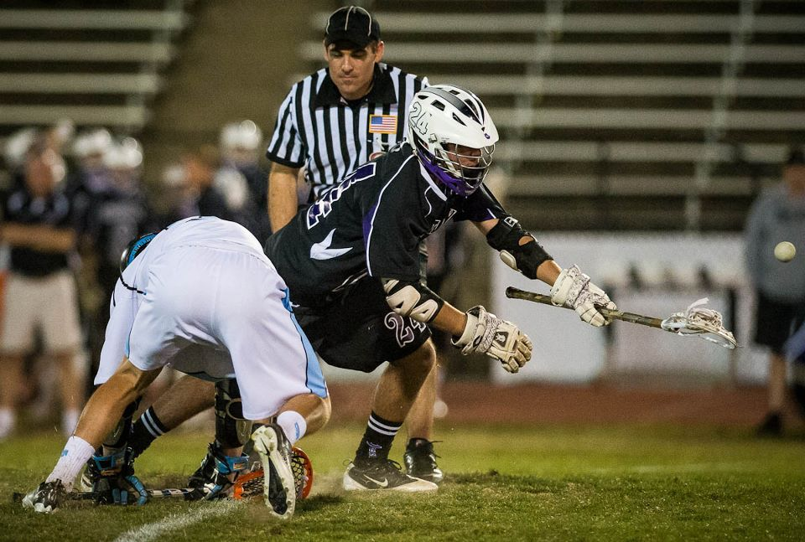
Pinch-and-Pop
Notes:
Pinch and pop is legal as long as….

Slide 22
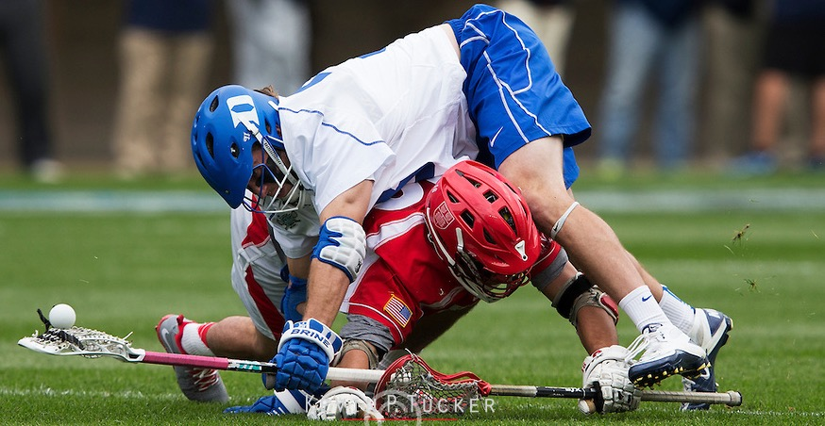
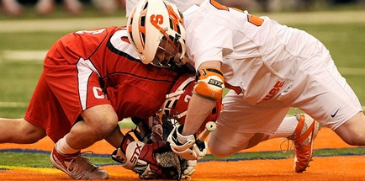
Holding During a Faceoff
Rule 4:3 Art. 5
Holding on a Faceoff
Rule 4:3 Art. 5
Notes:
Rule 4:3 Art. 5 Player may not use his body or crosse to hold or pin down the crosse of the opponent.
This is an exception to holding an opponent’s crosse during a loose ball rule.

Slide 23
https://youtu.be/O2xxDxG6_Mw
Notes:
Legal Contact or Holding (faceoff)? https://www.youtube.com/watch?v=O2xxDxG6_Mw
Who makes the call?
What do we need to decide?
Is the FO over?

Slide 26
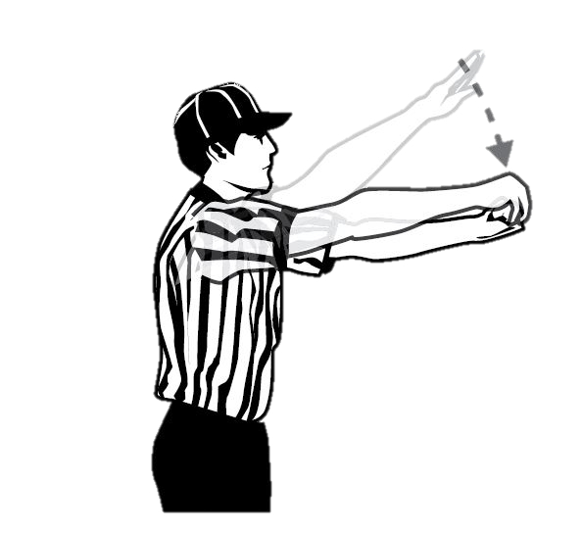
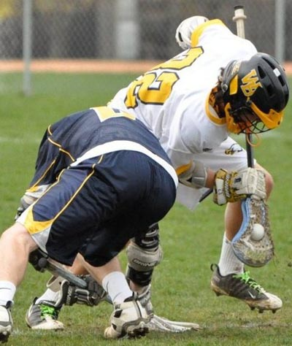
Ball in Back of Crosse
On a Faceoff, a player may not pick up and carry the ball in the back of his stick.
One Step
Rule 4:3-3
Notes:
A violation will be called if a player picks up and carries the ball on the back of his stick. It is legal to clamp the ball with the back of the stick, but it must be moved, raked or directed immediately. Immediately is defined as within one step.

Slide 27
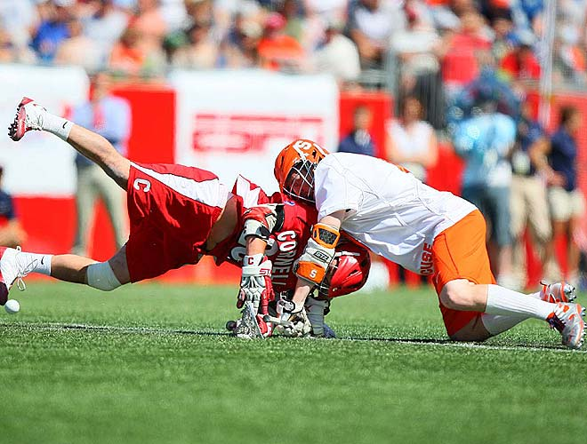
Withholding
Player may not lie on the ball or trap the ball with his crosse longer than is necessary to control and pick it up or withhold ball in any other manner.
Rule 6:12

Slide 28
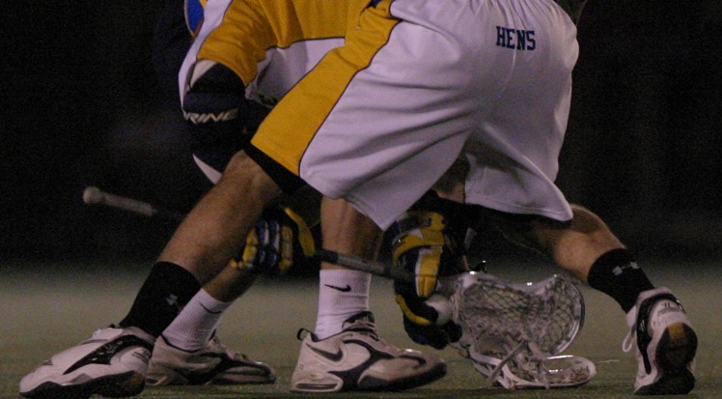
Where’s the ball?
Rule 5-10 d.
Notes:
Where is the ball? USC!
Alex Smith Delaware Blue Hens

Slide 29
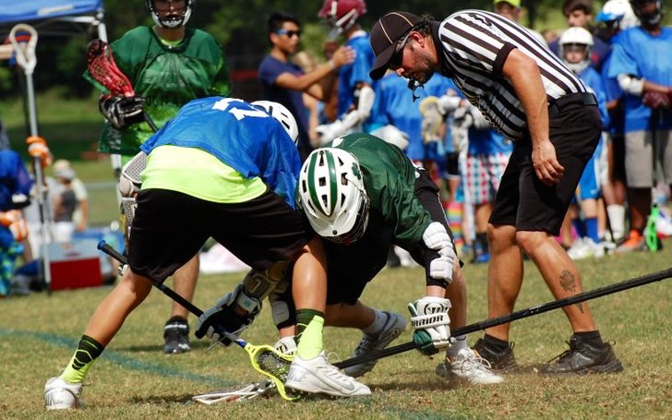
Body Contact on a Faceoff
Notes:
NO body checks are allowed if anything other than a players feet are touching the ground. There CAN be contact, but no body checks.
Players may make initial body contact on a face off, however the contact must be legal:
Above the waist
Below the neck
From the side
No part of the opponent’s body’s touches the ground (other than feet)

Slide 30
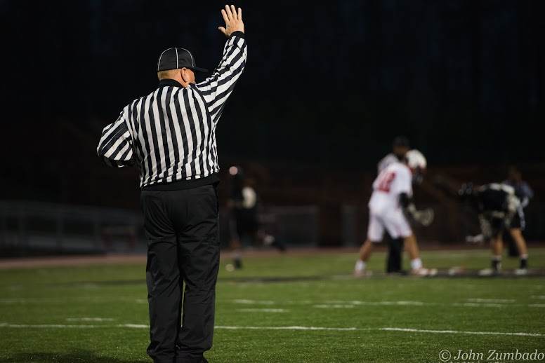
Don’t blow through a stop signal
Notes:
THIS IS REALLY IMPORTANT You are either READY or NOT READY there is no in between. Wing official manages the start of the FO.

Slide 31
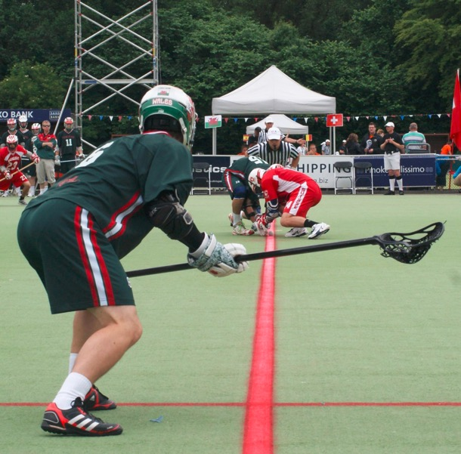
Wing Players
Must remain behind wing line. May be moving.
Released with whistle; but must avoid body checking the faceoff players battling for control of the ball in the initial faceoff spot
All other players are confined to their areas until possession is called, the ball goes OB or crosses the Defensive Area Line or a whistle stops play.
Rule 4:4
Notes:
Rule 4:4
If a team has players serving a penalty, they can chose not to have a wing player or bring a player up from either end of the field.

Slide 32
Notes:
Fogo crushed by wong

Slide 33
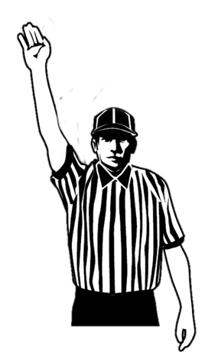
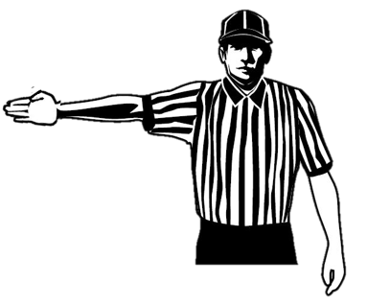
LL
FO
Watch for interference. Players who are far apart not likely to cause a problem.
Line up above the wing line to give yourself the best angle.
W
When the field is set point to the goal you are covering as Lead.
Wing Official Responsibilities
Notes:
Wing needs to set field and watch for both wings, you have to choose which one will likely cause most problem. Closer together has potential for problems. Don’t watch their backs, try to get an angle that will allow you to see from the front.

Slide 34
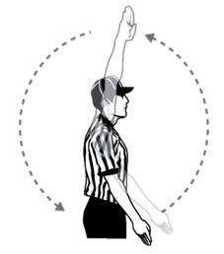
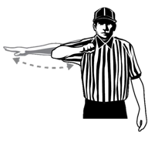
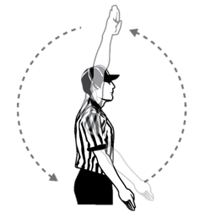
Possession
SS
LL
FO
Possession
W
Green Possession in Defensive End
Notes:
When play starts, F official backs out toward goal, then to correct sideline
F official has most possession calls: yell “Possession!” and wind arm
Other official echoes “Possession!”
Trail has 20-timer, if any; Lead has first 10-count

Slide 35
Possession
SS
FO
LL
Possession
W
Green Possession in Offensive End
Notes:
When play starts, F official backs out toward goal, then to correct sideline
F official has most possession calls: yell “Possession!” and wind arm
Other official echoes “Possession!”
Trail has 20-timer, if any; Lead has first 10-count

Slide 36
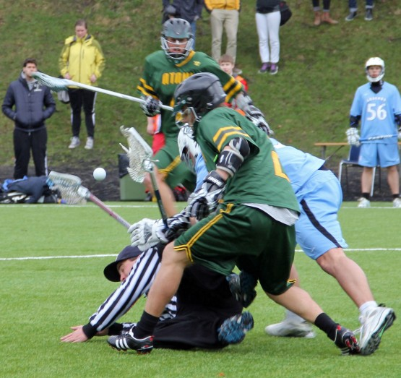
Notes:
Be aware of where the wing plays are, where you are going.

Slide 37
FO
LL
Player serving penalty may NOT release even if the penalty is expired until possession is called.
Green may NOT fill the spot with a player.
W
Man Down Faceoff
Rule 7:1
Notes:
When play starts, F official backs out toward goal, then to correct sideline
F official has most possession calls: yell “Possession!” and wind arm
Other official echoes “Possession!”
Trail has 20-timer, if any; Lead has first 10-count

Slide 38
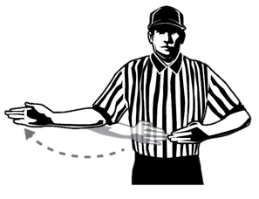
If ball goes OB in center field
officials see who was responsible: award ball.
If officials cannot determine who was responsible: re-face
Ball Out of Bounds at Midfield
Rule 7:1 d

Slide 39
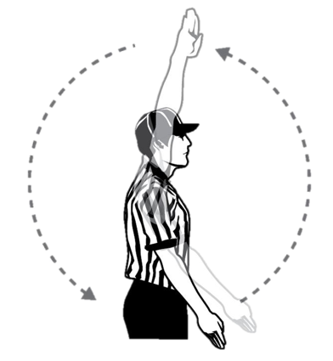
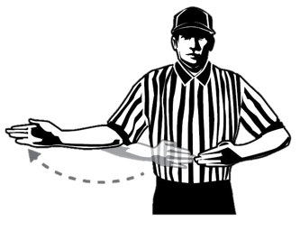
If ball crosses Defensive Area Line faceoff has ended.
Play!
When ball crosses Defensive Area Line and heads OB, award if you know who touched ball last or with AP.
Ball Out Crosses Defensive Area Line
Notes:
Rule 7:1 d

Slide 40
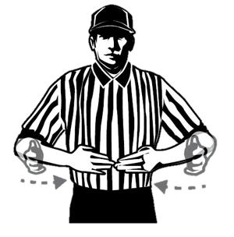
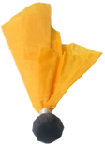
If an injury occurs requiring officials to halt play, reface.
If a foul is called (loose or time-serving), the faceoff has ended.
Injury or Foul on Faceoff
Rule 7:1 d

Slide 41
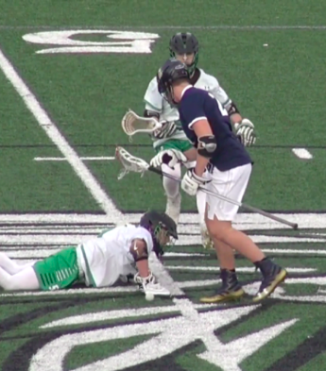
Quick Restart at Faceoff
If a player is awarded a free restart after a faceoff, players must be aware that they cannot play the ball carrier until the five yard buffer has been established.
Officials are NOT REQUIRED to move defensive player back.
Rule 4-5, 22
Notes:
Finally restarts at the faceoff can be challenging.

Slide 42
Notes:
Following a faceoff violation, it is the responsibility of all offensive players to get five yards away and defensive players to make sure the five-yard buffer is met before engaging. Blue and white players in this clip do a good job of giving the ball carrier a five yard buffer.

Slide 43
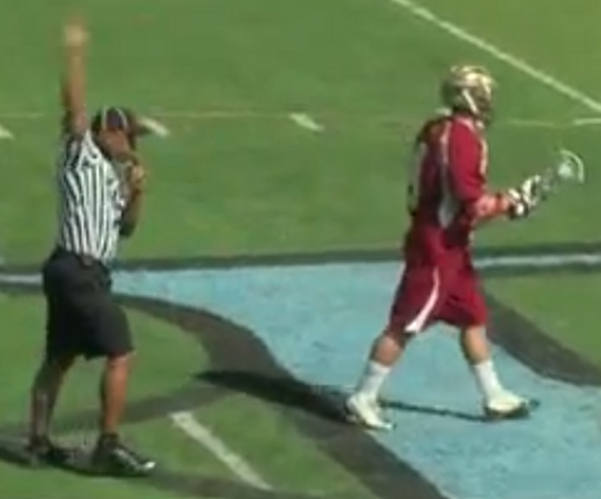
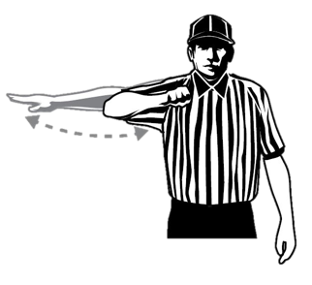
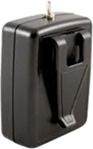
Restarts on Pre-Whistle Violation
BEFORE possession
Non-timeserving foul
Restart at spot where the ball was when play was suspended.
ALWAYS a Ten or twenty count.
Rule 4:4
Notes:
Watch out; players will be close to one another. Be sure to not to put someone into a delay of game (ie within 5 yards) situation.

Slide 44
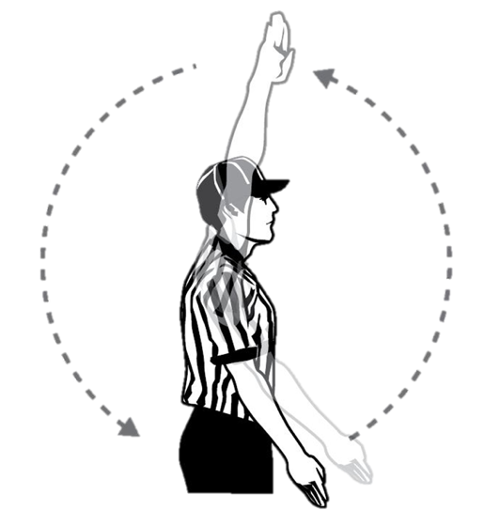
FO
LL
Player serving penalty may NOT release even if the penalty is expired until possession is called.
W
Man Down Faceoff
Rule 7:2 Situation E
Notes:
Green cannot enter the field until possession has been called even if penalty time expires!
Talk to the table to make sure they understand the rule prior to the faceoff.

Slide 45
Faceoff men and wing players may substitute freely.
Player behind Restraining Line are NOT released until whistle is blown to resume play.
FO
LL
W
Substitutions on Faceoff Violations
Rule 4:4-2 Situation B
Notes:
If a non-time-serving foul is committed before or during a faceoff (before possession is gained and before the ball crosses the defensive- area line), wing players will be released immediately, but players behind the defensive-area line will not be released until the whistle blows to resume play.

Slide 46
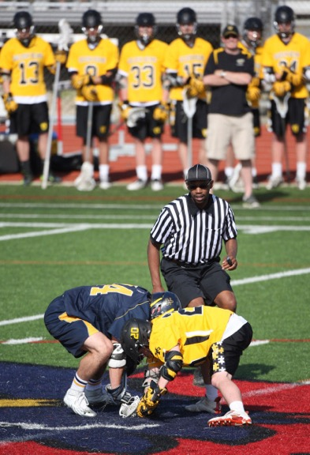
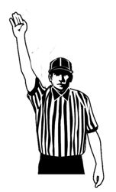
Faceoff or No Faceoff
A period will always begins with a Faceoff UNLESS:
Period ends with an uneven & a player is in possession.
OR
Period ends with a FDSW creating an uneven situation or a Play-on for a loose ball foul with an uneven situation.
6 on 5 not 5 on 5
Flag or Play on denotes possession.
Rule 4:3-1
Notes:
Five on five is NOT uneven
Flag denotes possession
Rule 4:3
For opening face, R decides.
Typically the R runs far side in the first half and bench-side in the second half.
U will normally be bench side to start each period, checking that table is ready and sub area is clear.
R takes all face-offs in overtime.

Slide 47
Thanks!

