Slide 1
Technical Fouls 2021 NFHS Boys Lacrosse Rules
Notes:
This presentation deals with rule 6. Goal is to make sure students understand that there is a fair amount of leeway when calling fouls as well as certain key guiding principles: Safety, Advantage Disadvantage as well as Obvious fouls.
Questions from 2017 NFHS Test
21. The officials use “Get It In/Keep It In” in which of the following situations?
a. Team in possession of the ball steps out of the box.
b. Under two minutes left in the game and the winning team has possession of the ball in their offensive half
of the field and is ahead by 4 goals or less
c. Team in possession of the ball is considered stalling outside of the box.
d. Both (b) and (c).
22. When is a team considered offside?
a. A team has more than 6 players in it is offensive half of the field including players in the penalty box.
b. A team has more than 7 players in its defensive half of the field, including players in the penalty box.
c. A team has 7 or less players in their defensive half of the field, including players in the penalty box.
d. Both (a) and (b).
61. B1 is playing A1. A1, running at full speed, cuts around A2, who had set up a screening position. B1, while playing A1, deliberately runs into A2. What is the correct call?
a. Legal, if B1 was concentrating on A1.
b. Unnecessary roughness against A2, 1-3 minute penalty.
c. Unnecessary roughness against B1, 1-3 minute penalty.
d. Either (a) or (c).
76. A1, advancing toward B1, carries his crosse in one hand, shielded behind his body. In which situations should A1 be called for warding off?
a. B1 swings at A1's crosse; A1 uses his free arm to absorb the check.
b. A1 contacts B1's crosse with his protecting arm and continues to drive against B1.
c. A1 contacts B1's shoulder with his protecting arm and pushes B1 out of his way.
d. Both (b) and (c).
78. A player may not interfere in any manner with the free movement of an opponent, except under which of the following circumstances:
a. The ball is in flight and within five yards of the players.
b. Both players are within five yards of a loose ball.
c. His opponent has possession of the ball.
d. All of the above.
79. A1 is within five yards of a loose ball. B1 holds A1’s crosse with his crosse, preventing A1 from participating in play. The ruling is:
a. Holding.
b. Legal check.
c. Cross-check.
d. Slashing.
80. For an offensive screen to be legal, which of the following is true?
a. The offensive player setting the screen may not place his feet more than shoulder width apart.
b. The offensive player setting the screen may spread his feet as far apart as possible.
c. The offensive player setting the screen can place his feet a maximum of 3 feet apart.
d. The offensive player setting the screen must have his feet together.
81. Player B1 legally body-checks ball carrier Player A1 causing the mouthpiece of Player A1 to fall out, but A1 maintains possession of the ball. What is the proper ruling?
a. No foul – legal play, but immediate whistle. Player must put his mouthpiece back in before continuing play. Team A restarts with possession.
b. Flag-down, slow whistle.
c. Immediate whistle. Award the ball to Team B.
d. Conduct foul; A1 serves 30 seconds.
82. A1, with possession of the ball, is checked legally by defenseman B1, whose crosse breaks. Which of the following is true?
a. There is no penalty unless B1 participates in the play in some manner after breaking his crosse.
b. Once B1 breaks his crosse, he shall either get a new crosse from the bench/table area or substitute out of the game.
c. B1 may carry the broken crosse off the field or leave it on the field.
d. All of the above.
83. A1, with possession of the ball, passes to teammate A2; during his follow-through, the head of A1's crosse falls to the ground. What is the correct ruling?
a. Play continues, since A1's crosse broke after the pass; A1 must not participate in the play and must either
obtain another crosse or sub out of the game.
b. Immediate whistle to stop play; penalize A1 for playing with an illegal crosse (1-minute nonreleasable).
c. Silent play-on; if Team A shoots, then Team B gets a free clear.
d. Immediate whistle to stop play; award possession to Team B.
84. B1 is serving a releasable penalty and enters the game before being released by the timekeeper. The official stops play when Team A scores a goal. What is the proper adjudication?
a. Goal is disallowed; Team A is awarded possession; B1 returns to the penalty area to serve his unexpired penalty time; B1 serves an additional 1-minute releasable penalty.
b. Goal is good; B1's unexpired penalty time is nullified and his 30-second penalty is erased.
c. Goal is good; B1 returns to the penalty area; B1's unexpired penalty time is nullified; B1 must serve 30 seconds for illegal entry into the game.
d. Goal is good; B1 is assessed a 1-minute nonreleasable penalty for unsportsmanlike conduct.
85. B1 is serving a releasable penalty and enters the game before being released by the timekeeper. The official stops play when Team B scores a goal. What is the proper adjudication?
a. Goal is disallowed; B1 returns to the penalty area to serve his unexpired time, plus 30 seconds.
b. Goal is disallowed; B1 returns to the penalty area, but does not have to serve an additional 30 seconds. Ball awarded to Team A.
c. Goal is good; B1 returns to the penalty area, plus an additional 30 seconds.
d. Goal is good; B1 returns to the penalty area, plus an additional 1-minute nonreleasable penalty.
87. During play, A1 has possession and is looking to pass the ball to A2 in front of the crease. Before the pass can be made, B1 checks A2's stick while the ball is more than five yards away. What is the proper ruling?
a. Immediate whistle. Award ball to Team A twenty yards laterally from the goal.
b. Immediate whistle. Penalize B2 for unnecessary roughness.
c. Flag down, slow whistle. Penalize B1 for interference.
d. Flag down, slow whistle. Penalize A2 for illegal offensive screening.

Slide 2
Push
Hold
Illegal Procedure
Delay of Game
Interference
Illegal Screen
Withholding
Warding
Illegal Touching
Substitution
Offside
Conduct
Stalling
Technical fouls are those of a less serious nature.
Deal with advantage disadvantage. Fairness.
Never player safety.
Technical Fouls
Rule 6
Notes:
Can they list the technical fouls?

Slide 3
The Principle of Advantage/Disadvantage
TPOAD says that you should not call a foul if it does not give an advantage to the team committing it or disadvantage the team receiving it.
Mostly for judgment calls; NEVER applies to line calls or safety calls.
Notes:
A term used during a loose ball, such as when Team A is told to keep it in, and the ball leaves the goal area.
In such a case, rather than blowing the whistle IMMEDIATELY, you let team B run with the ball if they get it and go on a fast break. If however team A gets the ball, or even contests for it, you apply the "disadvantage" portion and blow the whistle, awarding the ball to team B.

Slide 4
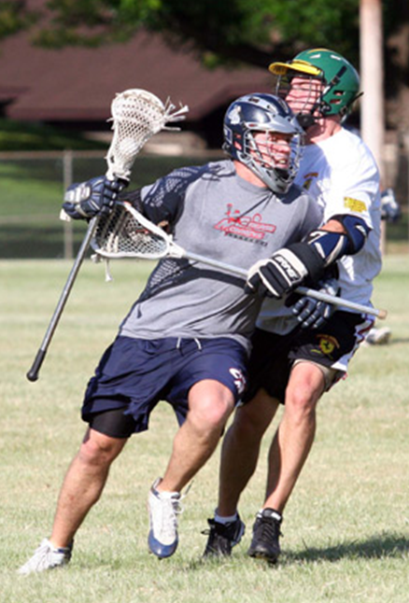
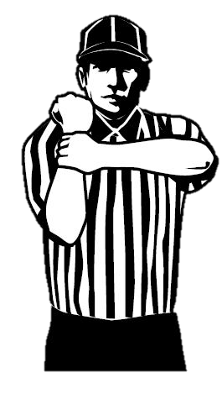
Player may not impede the movement of player or a crosse, hold an opponent with hand or body, hand or crosse.
May exert equal pressure on player in possession if both hands are on the crosse.
May hold player from the front or side or his crosse within 5 yards of a loose ball.
Holding
Rule 6: 3
Notes:
Rule 6: 3
More than simply grabbing. Impeding. Think basketball and equal pressure. If a player is moving in the direction he wants to go, it is not holding. Defender is entitled to his space. Sudden or unexpected movement, steering are good indicators of holding.
By rule, touching the back with the free hand while checking is holding.

Slide 5
Cross Check Hold
Hands > shoulder-width
Hands ≤ shoulder-width
Rule 6.3.2a / 6.3.3e
Notes:
ART. 2… a. Use the portion of the handle that is between his hands to hold an opponent, when his hands are more than shoulder width apart.
ART. 3… e. Use the portion of the handle that is between his hands, which are no more than shoulder-width apart, to hold an opponent on the torso with no more than equal pressure and no thrusting motion.
Rationale: Clarifies legal and illegal holds to an opponent.

Slide 7
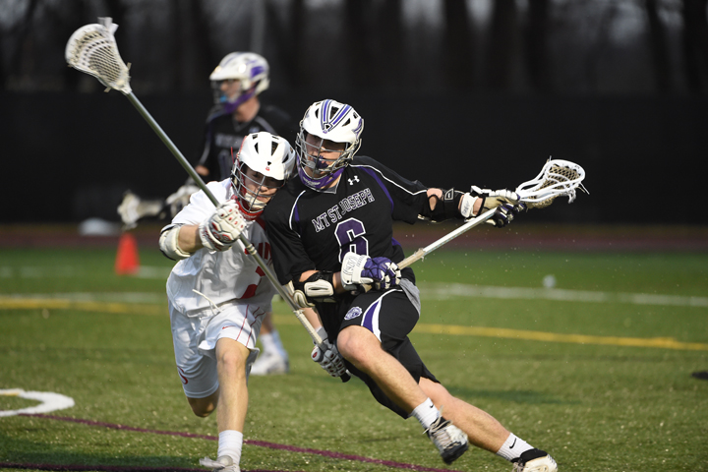
Equal Pressure
Notes:
e.g. of equal pressure.

Slide 8
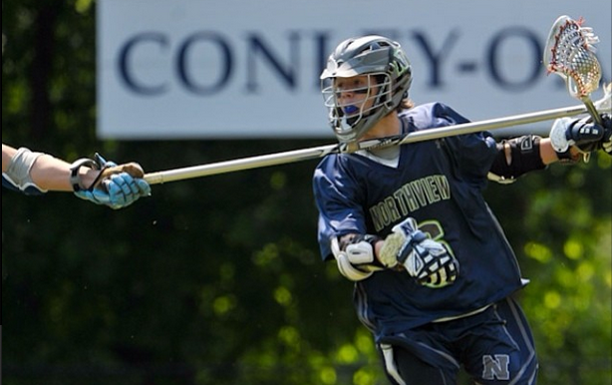
Notes:
Contact that is not serious or dangerous i.e. not safety, is sometimes called holding. This is because the payer is disadvantaged by the contacts (e.g. changes eye line) and it looks bad (i.e. obvious) so folks want something called.

Slide 9
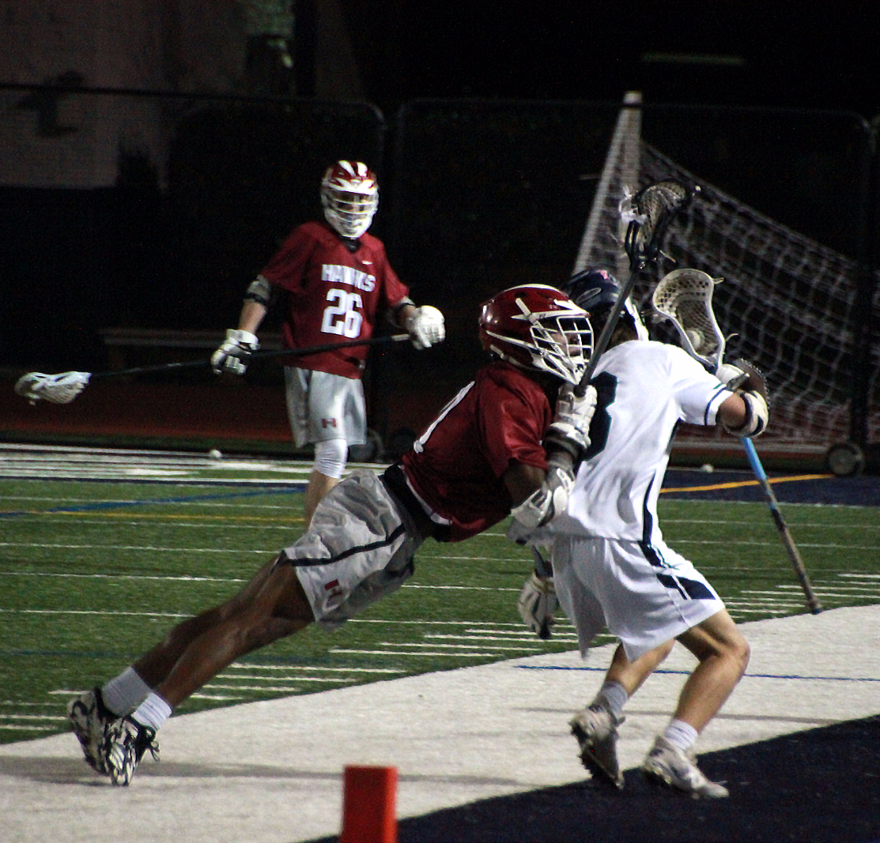
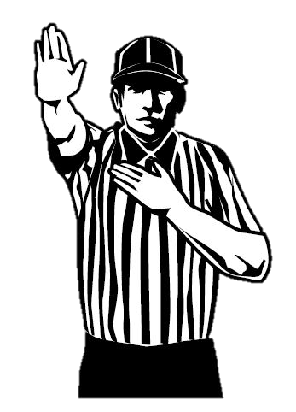
Pushing from BEHIND is illegal:
From behind
Creates disadvantage
Violent contact is a personal foul!
Push
Rule 6: 9
Notes:
Pushing is legal
closed hand, shoulder, or forearm
both hands on the crosse
from the front or side
when the opponent is in possession
or within 5 yards of a loose ball.
Rule 6: 9 NOT from BEHIND!
Where this foul occurs is often the determining factor.
Midfield
Sideline
Crease
Going to Goal
BB officials: NOT two hands!

Slide 10
Pushing from FRONT or SIDE is legal
Push
Rule 6: 9
Notes:
Pushing is legal
closed hand, shoulder, or forearm
both hands on the crosse
from the front or side
when the opponent is in possession
or within 5 yards of a loose ball.
Rule 6: 9 NOT from BEHIND!
Where this foul occurs is often the determining factor.
Midfield
Sideline
Crease
Going to Goal
BB officials: NOT two hands!

Slide 11
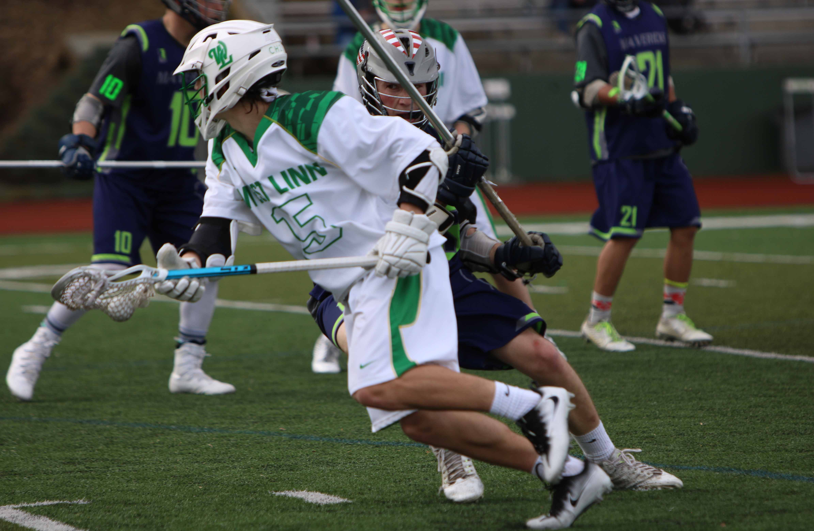
Notes:
You can’t see if there is a push from here, work to get into the best position to see the contact in the back.

Slide 12
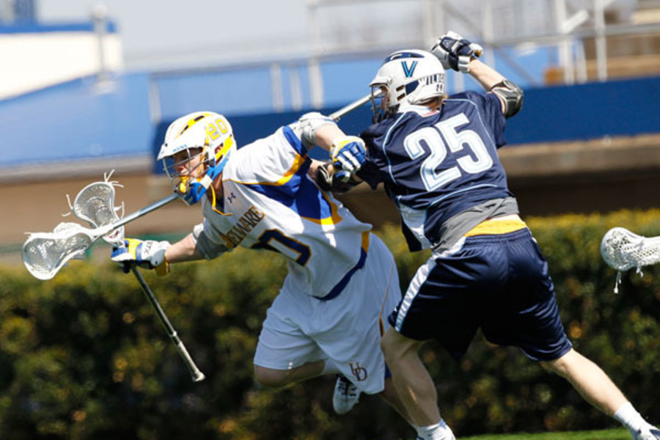
Notes:
This is where the push will occur. You must be in position to see the area in between the two players.

Slide 13
Notes:
This could be a push or it could be he turned. Lead has to get in better position to lend credibility to the call.
Turning at the last minute is a no call if only advantage disadvantage.

Slide 14
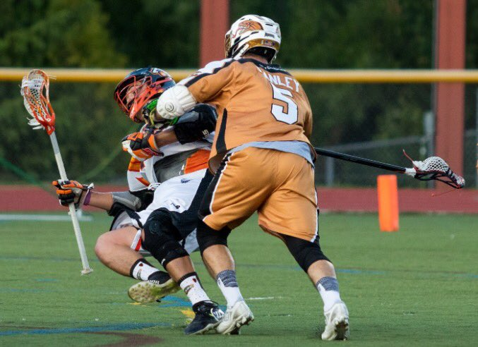
Notes:
Push from the front or side is LEGAL
Into crease, out of bounds, over midline etc…. As long as it is from the front or side.

Slide 15
Push?

Slide 16
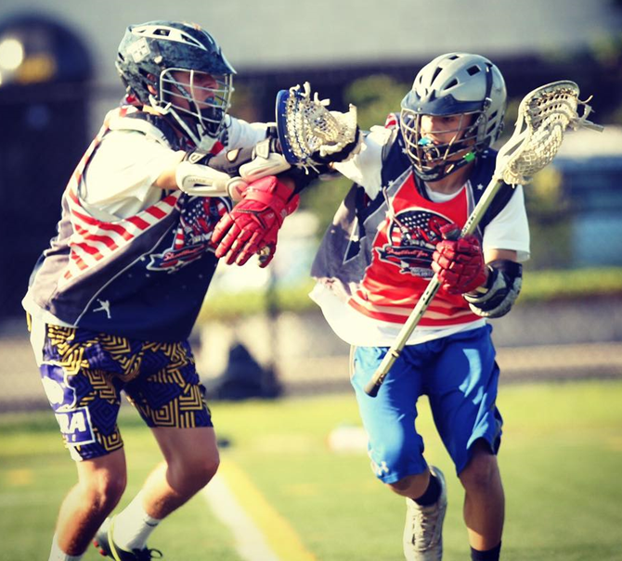
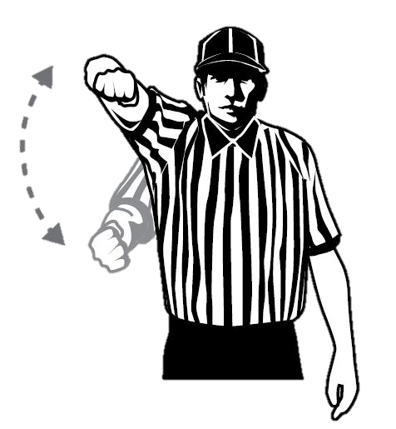
Player SHALL NOT use free hand, arm, other part of body to hold, push, control direction of movement of crosse or body of player applying a check.
Not to be called on a player with two hands on his crosse.
MUST be contact & advantage!
Warding
Rule 6:11
Notes:
Rule 6:11
Advantage/Disadvantage.
if the offensive player lifts his arm over the defender’s stick, that does not constitute a ward.
NFHS released a rules memo regarding the ward on February 26, 2018. The rationale is that as long as the offensive player has two hands on the crosse, a requirement for a legal body check in Rule 4.15, he should be allowed to initiate legal body contact whether he is an offensive or a defensive player.
A spear should be penalized with a minimum time of 2-minutes NR.
Lowering the helmet into the other player’s helmet or body is a spear. Potential for ejection as with any check involving the head/neck if excessive or severe.
If the body contact is judged as legal, the offensive player shall not be called for a ward. The contact is either legal, or it is unnecessary roughness.
NOT a license to foul

Slide 17
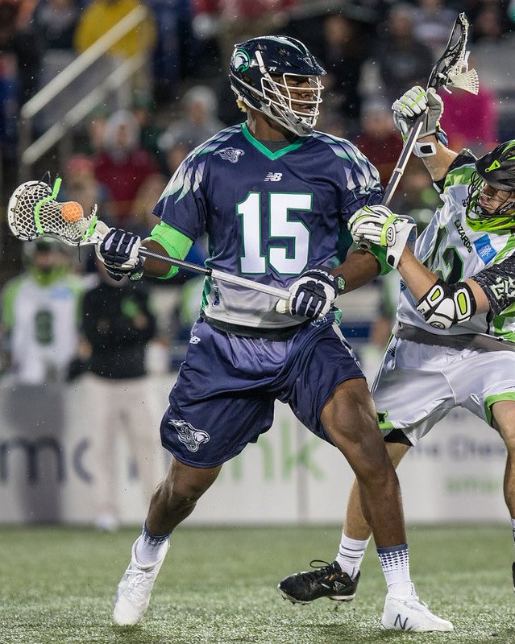
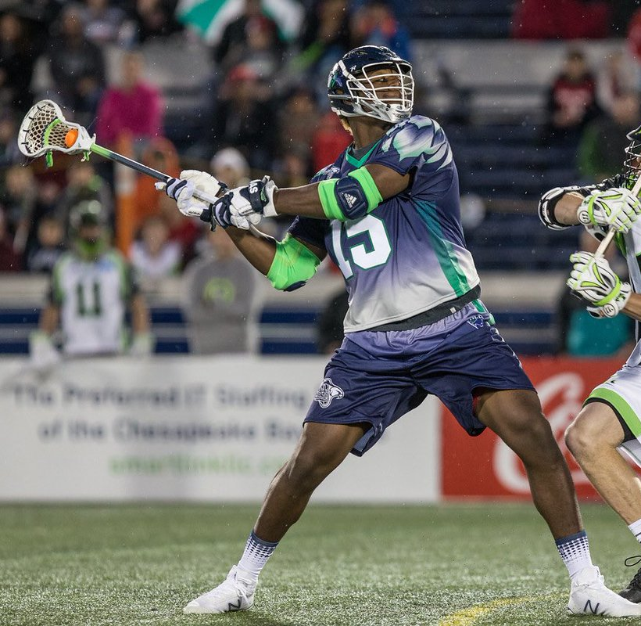
Contact by A with Two Hands on Crosse
Contact with crosse
Contact with crosse
Hands free to shoot
Rule 6.11.1 Situation C
Notes:
6.11 SITUATION C: A1, with both hands on his crosse, raises his forearm and directs B1’s (a) crosse or (b) body away from himself, creating space. RULING: (a) legal play. (b) warding off; award the ball to Team B.
Rationale: Clarifies warding and creates an enforceable situation.
6.11 SITUATION C: A1 addresses the type of legal contact the committee envisioned
with both hands on his crosse, A1 raises his forearm and directs B1’s (a) crosse away from himself, creating space. RULING: (a) legal play.

Slide 18
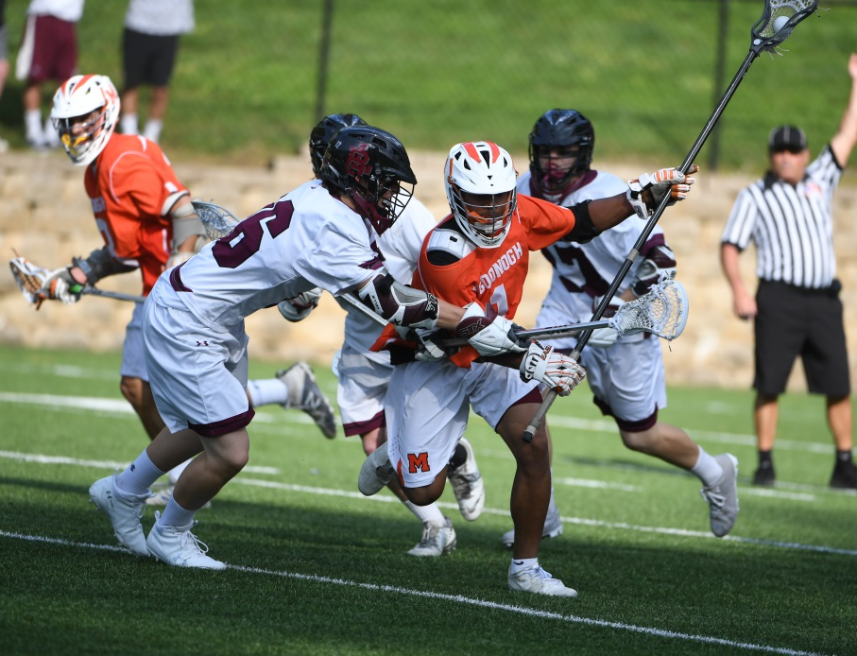
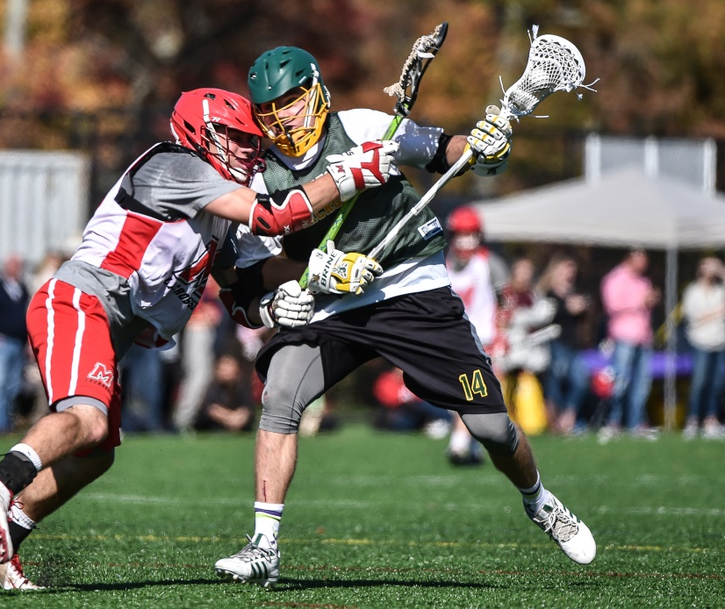
Ward
Contact with crosse
Contact with body
Rule 6.11.1
Notes:
This season the committee further clarifying what the meant by warding.
This season, a player in possession of the ball may NOT use his free hand or arm to hold, push or control the direction of the movement of the crosse or body of the player applying the check.
A player in possession of the ball with BOTH hands on his crosse shall NOT use his hand or arm to push the BODY of the player applying the check, but may initiate contact against the crosse of his opponent to gain an advantage
Crosse good, body bad.
Any contact that would fall under Illegal body checks, “spearing” and unnecessary roughness shall be strictly enforced as Personal Fouls.

Slide 19
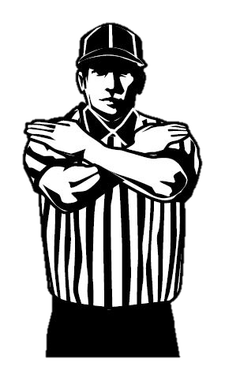
Cannot interfere with the free movement of an opponent unless they are in possession of the ball or within 5 yards of a loose ball.
Occurs AWAY from the ball!
Interference
Rule 6: 7
Notes:
Rule 6: 7
Off official away from the ball!

Slide 20
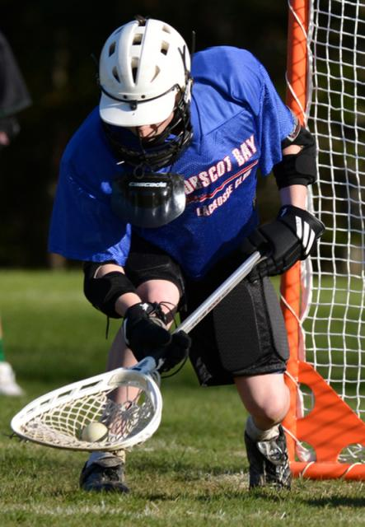
No opposing player can make contact with goalie or his crosse:
inside the crease
or
any part of keeper crosse in or outside of the crease when the goalie has possession and is in the crease.
Goalie Interference
Rule 6: 2
Notes:
Rule 6: 2
NOT a timer serving penalty EVEN if possession! They can attempt to play a loose ball.
Loose ball interference award possession to B lateral from goal.
With possession, free clear. ONLY GK gets these protections.

Slide 21
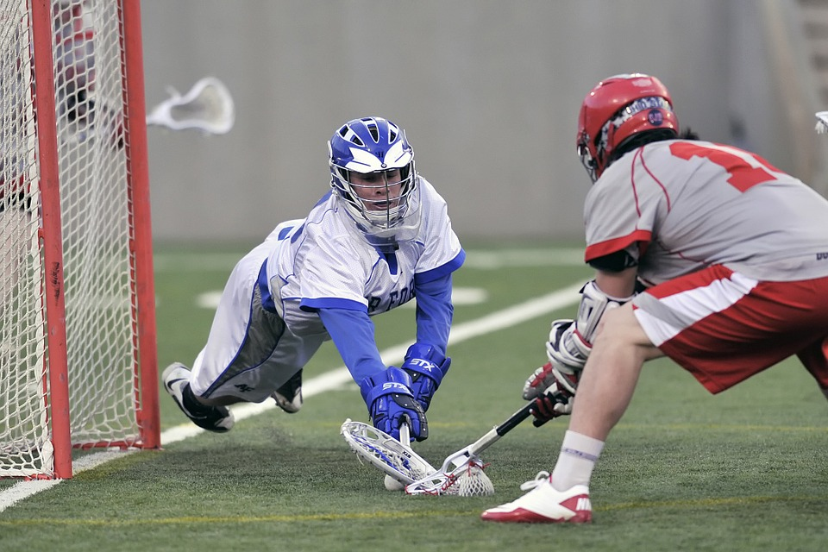
Notes:
Possession but where? OUTSIDE of crease. Who initiated contact?

Slide 22
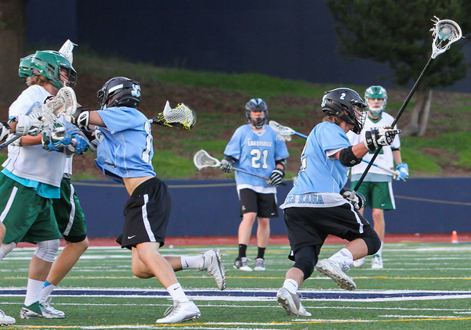
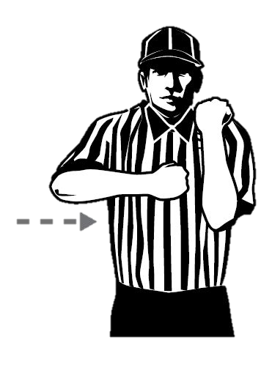
Must remain motionless.
Must keep his crosse within his body.
Legs must be shoulder width.
MUST be contact!
Illegal Screen
Rule 6: 4
Notes:
Rule 6: 4
Can’t have legs wider than shoulder, can’t have stick horizontal to ground.

Slide 23
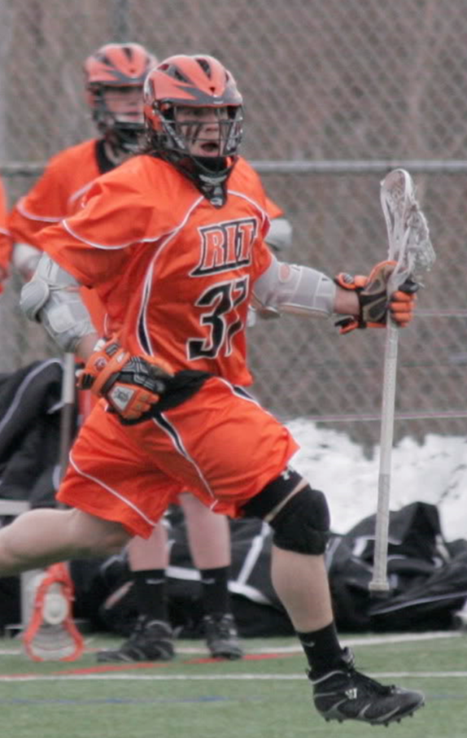
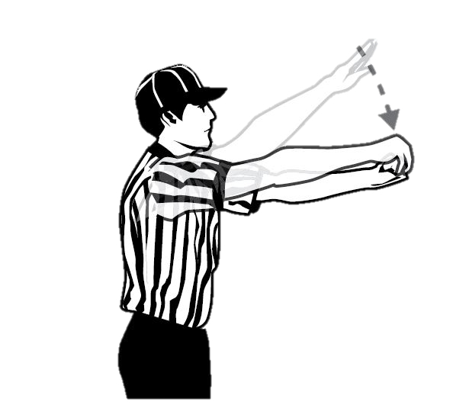
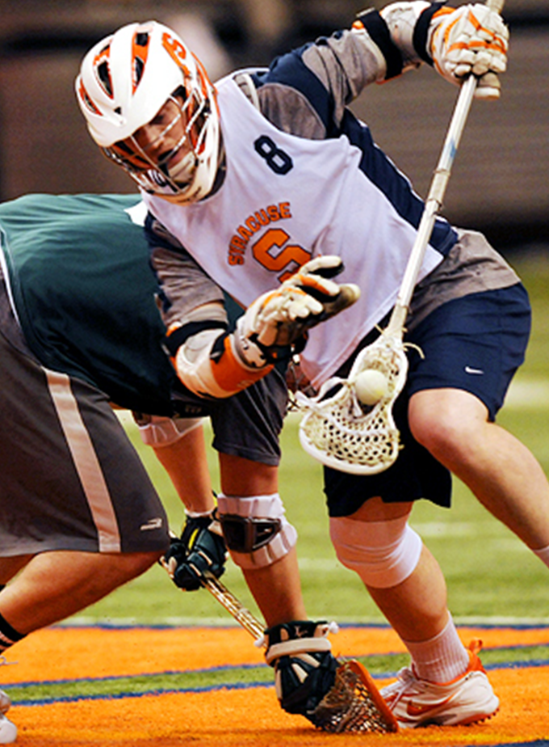
Player may not:
lie on the ball.
trap the ball with crosse any longer than is necessary to control.
withhold ball in any manner.
one step on FO with ball in back of crosse.
Immediate
Whistle
Withholding
Rule 6:12
Notes:
No two shakes!
One step on Faceoff!
This rule applies when a player loses his crosse and the ball remains in or under the head of the crosse.
New rule on faceoff this year; player gets one step if they come up with the ball in back of crosse.

Slide 24
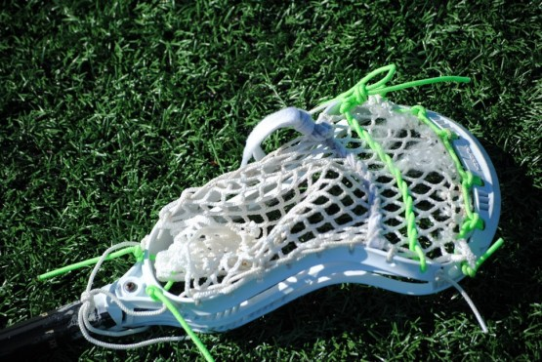
Notes:
Immediate whistle for ball in crosse on ground.

Slide 25
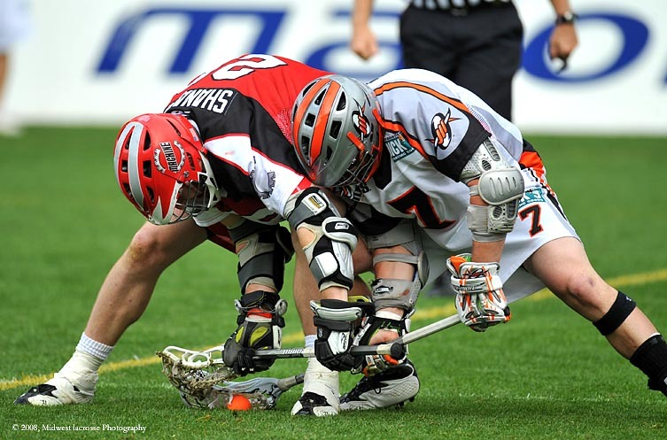
Notes:
Is this withholding? Or Holding?

Slide 26
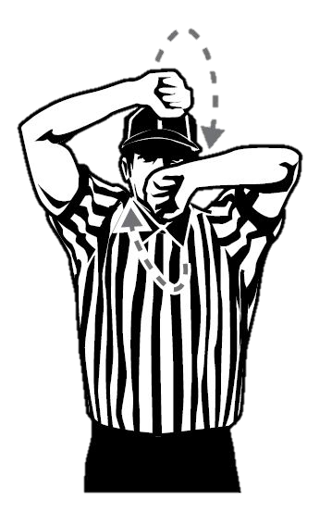
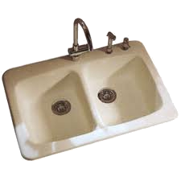
Playing without a crosse.
Flicking crosse in opponents face.
Enter game before penalty time has expired.
Participating from Out of Bounds.
Leaving restraining area before Faceoff ended.
More than 10 men on the field.
Crease violation.
No working horn.
More than 4 long crosses.
Mouthpiece.
Failure to give 5 yards on restart.
Exchanging crosse while in possession.
Illegal Procedure
Rule 6:5
Notes:
Kitchen sink. When in doubt on a technical foul use this signal. Mouthpiece new rule and POE.
This is a go to signal if you can’t remember one for a technical foul
Two or more requests for equipment or long pole count that fails to find a violation, charge T.O.
6.5.2b4 (NEW) – Exchange crosses
ART. 2… b. Illegal actions with crosse – A player shall not:…
4. Exchange his crosse with that of a teammate during live play while the ball is in either crosse.
Rationale: Prevents a potentially dangerous play that could result in a shot released toward an unsuspecting and unprepared goalkeeper.

Slide 27
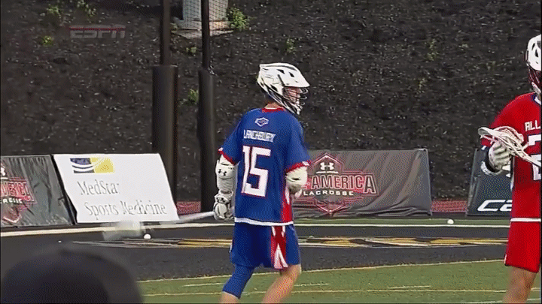
Playing without the Crosse
Rules 6:5-2
Notes:
What does participation mean? Setting a pick, pushing, body contact.
Running to get crosse is not in and of itself participation.

Slide 28
Throwing the crosse at a ball, player or other game personnel is considered unsportsmanlike conduct.
In all other cases falls under illegal procedure.
Throwing the Crosse
Rules 5-10 and 6:5-2

Slide 29
Exchanging Crosses
Rule 6.5.2b4
Notes:
This years rules specifically state that no player is allowed to
exchange his crosse with that of a teammate during live play while the ball is in either crosse.
The committee wanted to prevent a potentially dangerous play that could result in a shot released toward an unsuspecting and unprepared goalkeeper.
The “hidden ball trick” remains a legal play as long as the crosses are not exchanged with the ball in one of the crosses possession

Slide 30
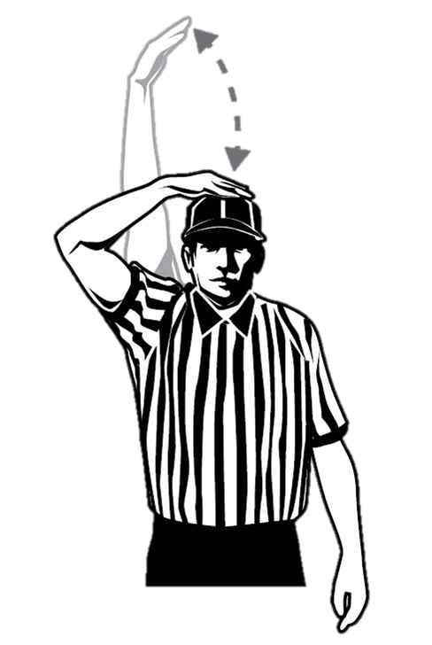
Once a 10 or 20 count has begun, it continues until:
Ball crosses midfield line or attack box.
Change of possession.
Whistle.
Failure to Advance
Rule 4:13-14
Notes:
Failure to advance on ten, twenty count.
Ball that touches the line or the attack box is in and ends the count. You don’t need possession to end a count.

Slide 31
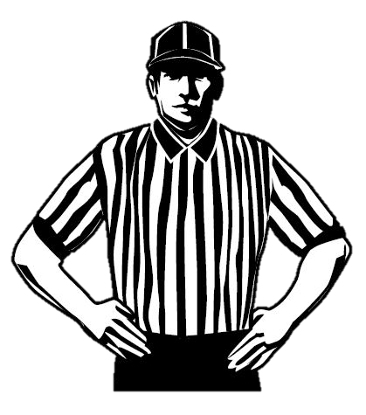
A team is not considered offside if a team with too few players at either end of the field has not gained an advantage, including those serving penalties.
Count Forwards
Offside
Rule 4:10-12
Notes:
Need to have too many! Advantage
Count A, then B; ignore goalie. If A offsides WHISTLE, if B FDSW
Too few (see diagram) is fine.

Slide 32
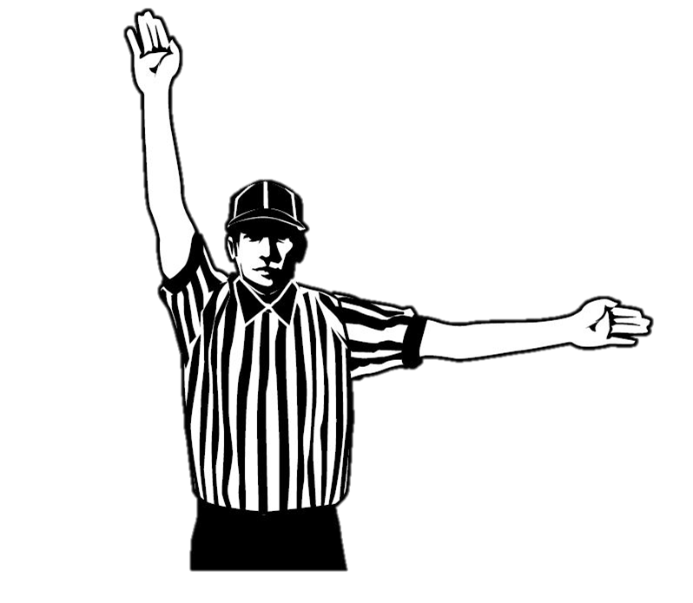
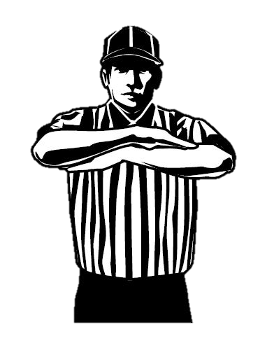
Stalling: judgment call.
No GIKI: Team up by 4 or less in final 2 minutes of game.
Get it in Keep it in
Rule 4:31
Notes:
Judgment call for stalling:
Change in offense (situational)
Passing on open shots
Wasting time after subs
Silent play on
Delay of game is signal for failure.

Slide 33
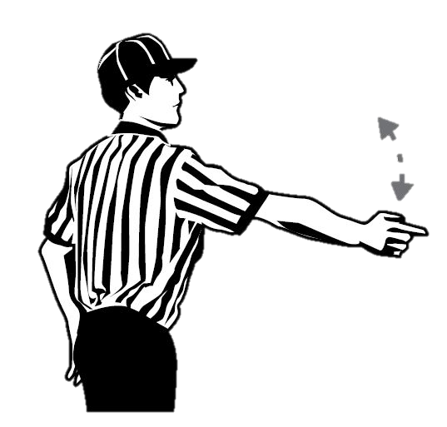
Ten count MUST be satisfied.
Must cross and touch.
Not a plane!
Team A may bat, but may not possess.
Over and Back
Rule 4:31
Notes:
Must cross and touch: not a plane.
Treat as a play on if defense likely to gain possession and advantage.
Even in U 9 and U 11 games where there is no requirement to touch it in.

Slide 34
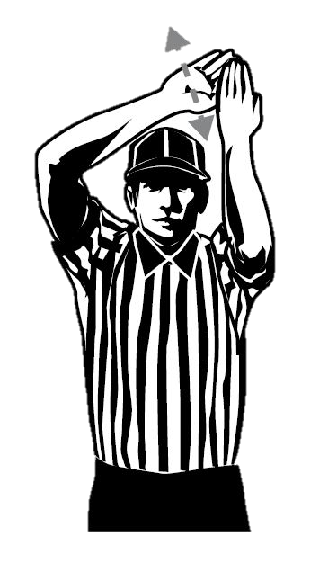
Tip!
Officials MUST work together and communicate:
10 count has ended.
Communicate: Shot, tip or pass.
Give tip signal.
Trail makes call; heads to GLE.
Lead has restart!
Over and Back
Rule 4:31
Notes:
Must cross and touch: not a plane.
Treat as a play on if defense likely to gain possession and advantage.
Silence = over and back as far as your partner knows.

Slide 35
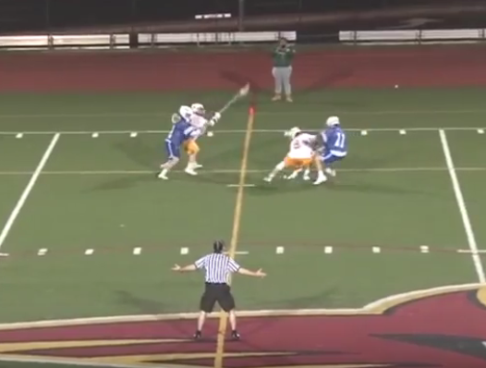
Notes:
Team A may bat kick but not possess.
Ball must touch; not a plane.
Hands wide means I need help!

Slide 36
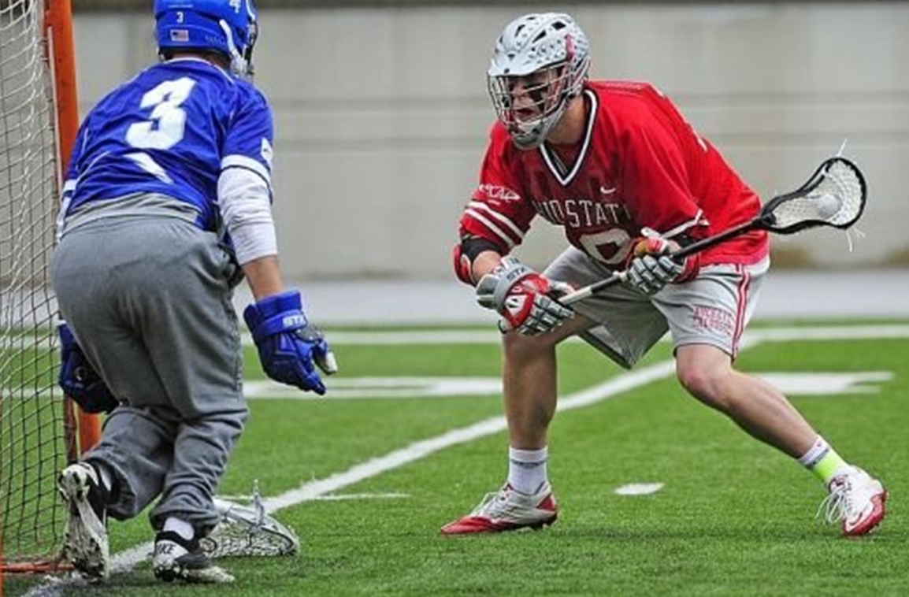
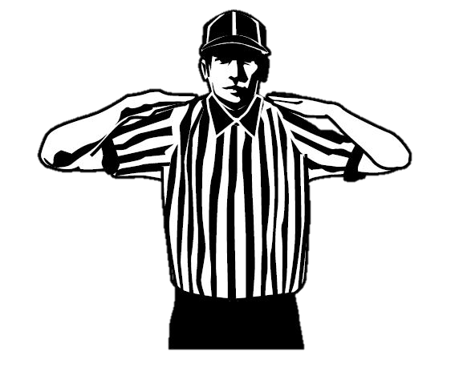
A player shall not touch the ball with his hands while it is in play.
EXCEPTION: Goalie may bat the ball in the crease.
Illegal Use of Hands
Rule 6:5 Art. 2 4:18
Notes:
Goal Keeper may not touch the ball outside of the crease with his hand EVEN if he is within the crease!

Slide 37
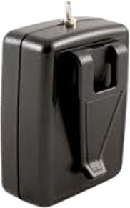
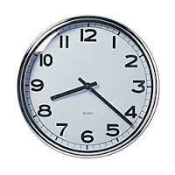
Failure to be ready for play within 20 seconds.
Failure to ready the ball for play on stoppage.
Avoidable lateness of team.
Failure to yield 5 yards on free restart.
Delaying the Game
Rule 6:5 d, f, i

Slide 38
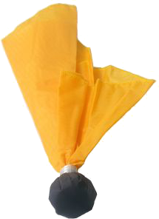
Delay of Game
MAY restart if a defensive players is within 5-yards.
Defensive player MUST allow the offensive a direct path to the goal.
May not defend the player until he establishes five yards.
Offensive player cannot initiate contact to draw the flag and gives up his advantage if running
East-West (i.e. sideline to sideline).
FDSW
Rule 4:22-1
Notes:
In settled situation, On official signals ball ready for play, resume play in 5 seconds or immediately if player outside goal area, no player within 5 yards of ball and officials in position. Make eye-contact prior to restart before face-offs and after penalties, timeouts, and sideline horns. If ball within goal area, move laterally outside area. Always give goalie 5 seconds to re-enter crease. If the restart is to be within 10 yards of the centerline on the bench side, move the ball 5 yards from the sideline.
No player, A or B, within 5 yards.
Even amongst some of the more recent shooting string specs and shot clock implementations, the banning of "The Armadillo" will remain one of the most memorable rule changes ever in the history of lacrosse. Drummed up by Coach Jack Emmer during his time at Washington & Lee, the play was intended to level the playing field, so to speak, between W&L and a far more talented UNC team in 1982.

Slide 39
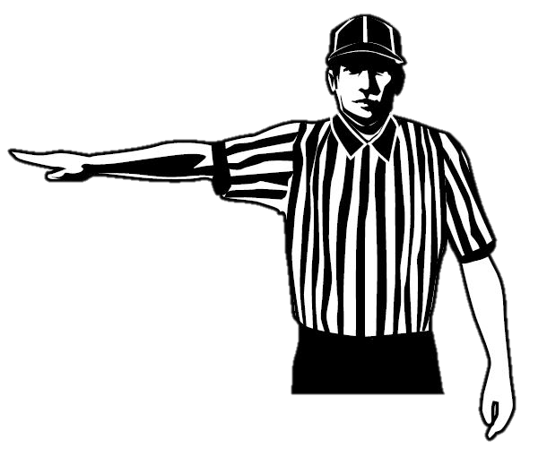
The Half Bird: sends message to the player or coach.
Loose ball: award possession.
Possession: Take ball away or 30 second penalty.
Conduct
Rule 6:6
Notes:
The Half Bird.
e.g. Foul language by anyone officially associated with a team, on the field or sidelines, merits at least a conduct penalty.

Slide 41
Thanks!

