Slide 1
Personal Fouls 2021 NFHS Boys Lacrosse Rules
Notes:
This presentation deals with rule 5. Make sure students understand that there is a fair amount of leeway when calling fouls as well as certain key guiding principles: Safety, Advantage Disadvantage as well as Obvious fouls. Video are great, but photos also help to emphasize the fact that unless an official sees the full play in context it is very difficult to know whether a foul has been committed or what foul one should call.
Have students stand and repeat when you demonstrate the signal! Emphasize the need to master this skill.
Questions from 2017 NFHS Test
14. An assistant coach for Team B commits an unsportsmanlike act. The official should call:
a. A penalty for unsportsmanlike on the head coach, the in-home serves the penalty
b. A penalty for unsportsmanlike conduct on Team B’s in-home, the in-home serves the penalty
c. A penalty for unsportsmanlike conduct on Team B’s assistant coach who committed the unsportsmanlike act, the in-home serves the penalty
d. None of the above.
60. During a dead, ball players A1 and B1 enter into an argument severe enough to draw a flag on both players. The result will be:
a. Offsetting conduct fouls.
b. No penalty since it was a dead ball situation.
c. Unsportsmanlike conduct fouls on A1 and B1.
d. Either (a) or (c).
64. A1 is in possession of the ball as B1 initiates a body check. Just before contact is made, A1 turns his back to avoid B1. Which of the following would NOT result in a penalty against B1?
a. B1 hits A1 below the waist.
b. B1 cross checks A1, delivering a blow with the handle of his crosse.
c. B1 hits A1 from behind.
d. None of the above would result in a penalty.
65. Which of the following would be considered body checking a defenseless player?
a. Body checking a player who has his head down in an attempt to play a loose ball.
b. Body checking a player from his blind side.
c. Body checking a player whose head is turned away to receive a pass, even if that player turns toward the contact immediately before the body check.
d. All of the above.
66. Which of the following are mandatory 2-3 minute penalties?
a. Targeting a defenseless player.
b. Body-checking a player from his blind side.
c. Entering the field from the substitution area and body-checking a player who was looking the other way.
d. All of the above.
67. A multiple minute, nonreleasable penalty (or ejection if excessively violent) should be called on which of the following fouls:
a. A player initiates contact to an opponent's head or neck with a cross-check or with any part of his body,
including follow-through to the head or neck.
b. A player delivers an excessive, violent or uncontrolled slash to the head/neck.
c. A player, including an offensive player in possession of the ball, blocks an opponent with the head or initiates contact with the head (known as spearing).
d. All of the above.
68. Defenseman B1 initiates violent contact with A1’s helmet using his own helmet. Which of the following is a possible penalty for this?
a. Flag down, personal foul; B1 serves 2 or 3 minutes nonreleasable.
b. An excessively violent violation of this rule may result in an ejection.
c. Flag down, personal foul; B1 serves 2 minutes releasable.
d. Both (a) and (b)
72. The striking of an opponent in any part of the face or on the neck or head by the crosse of an opponent is called “slashing,” except when committed by the player in the act of:
a. Passing.
b. Shooting.
c. Attempting to scoop.
d. All of the above.
62. A player is considered to have fouled out of the game and not considered ejected in which situation(s)?
a. A player who accumulates 5 minutes of personal fouls.
b. A player who accumulates 5 fouls.
c. A player who receives a second, nonreleasable, unsportsmanlike conduct foul.
d. Both (b) and (c).
63. Which of the following would result in the assessment of an ejection foul on a coach or player?
a. He receives two nonreleasable unsportsmanlike conduct penalties.
b. He leaves the bench area during a fight.
c. He deliberately strikes another player after the end of the game.
d. All of the above.

Slide 2
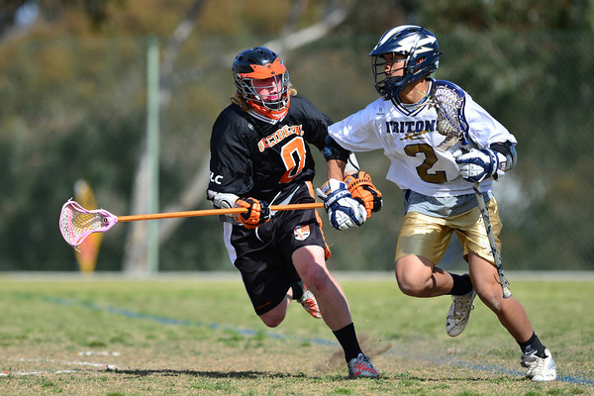
In Possession
or within 5 yards of a Loose Ball
Front or Side
Shoulder to Waist
Body Checking
Rule 4:15
Notes:
Lacrosse is a skill sport that allows some contact. May check an opponent in order to:
Try to dislodge a ball from an opponent by attacking their stick with your stick.
Try to harass or disrupt an attacking player.
Try to block or move an opponent from picking up a loose ball.
For the check to be legal it must be:
Opponent may not have any part of his body other than his feet touching the ground.
Both hands must be on the crosse.
May not be delivered with a punching blow.
May not extend up into the head.

Slide 3
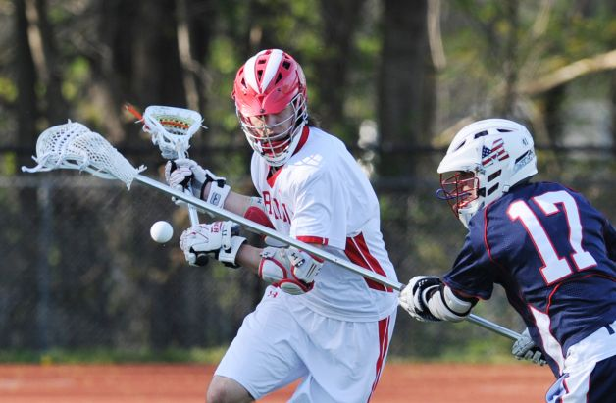
Within 5 yards of the ball, in possession, in flight or loose.
In an attempt to dislodge the ball
Gloved hand touching the crosse is part of the crosse.
Checking with the Crosse
Rule 4:16

Slide 4
Personal Fouls serious nature. Penalty 1 , 2 or 3 minutes depending on severity and perceived intent. Rule 5
Releasable/Non-Releasable released when the offended team scores a goal or full time. Rule 7:2-b
Technical less serious nature and include all violations of the rules not personal or ejection fouls. 30 seconds or awarding of ball to offended team. Rule 6
Live Ball occur during play.
Dead Ball occur after a whistle or the action requiring a whistle. Rule 7:5
Simultaneous live ball fouls on both teams occurring during the same whistle or dead ball fouls in which sequence cannot be determined. Rule 7:6
Types of Fouls
Notes:
Aim here is to let the students realize that foul recognition and management are a major part of the game and much more complicated then they realize.
Give them this situation.
A1 has possession, is slashed by B2. FDSW. A shoots and scores. A1 slashes B2.
What do you do?

Slide 5
Slash
Crosscheck
Tripping
Illegal Body Check
Targeting Head and Neck
Unnecessary Roughness
Unsportsmanlike Conduct
Illegal Equipment/Crosse
Ejection
Fouls of a serious nature!
Player safety and conduct. Play that is unnecessarily rough, dangerous or unsportsmanlike.
1 to 3 minute suspension from the game, usually at the discretion of the official.
Personal Fouls
Rule 5:1

Slide 6
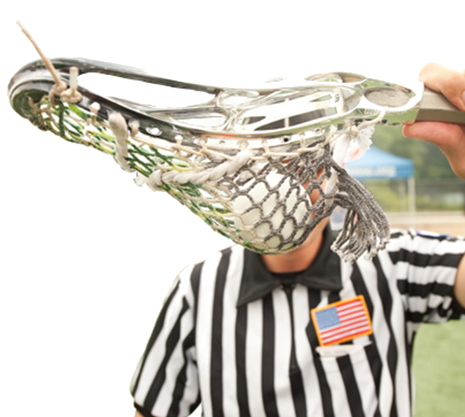
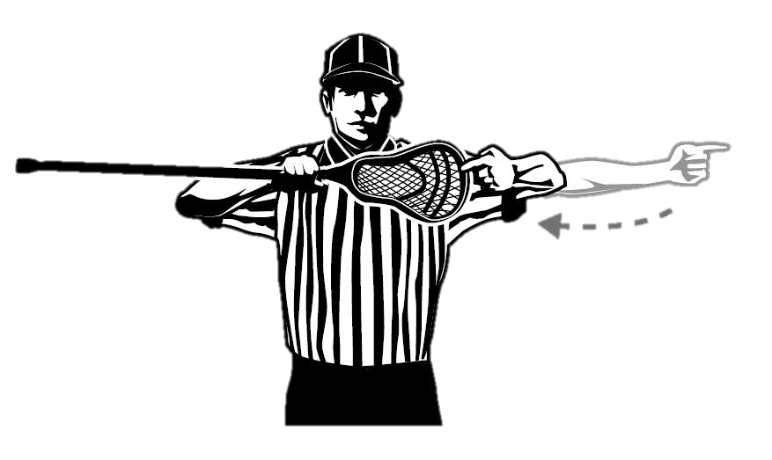
May not use a crosse that does not conform to required specs
Two-minute NR and can be fixed
Illegal Crosse
Rule 5:5
Notes:
Rule 5:2
Thrusting, viscous and deliberate. Simply making contact with crosse in between hands is not enough.

Slide 7
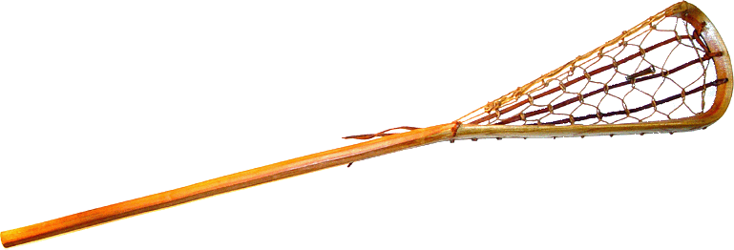
Crosse Requirements
Wood, laminated wood or synthetic.
Hollow handles must have manufactured plug.
Length: 40” to 42” OR 52” to 72”
Handle must be “relatively straight.”
not < 3.5” in circumference.
Net can be gut, rawhide, linen or synthetic material woven in triangular shape; may not ensnare.
A broken crosse is not a crosse.
Rule 1:6-8
Notes:
May not be made so as to snare opponents crosse. Side wall can be of weaving gut lacing.
Emphasize a broken crosse is not a crosse so that person is no longer a legally equipped player.
Rule 4-3-3n now specifically states the circumference of the shaft shall not exceed 3.5 inches, and a contrasting color between the head and the top glove must be visible on the shaft during faceoffs (it may be tape or paint).
Adjustable handles are illegal Rule 1:7

Slide 8
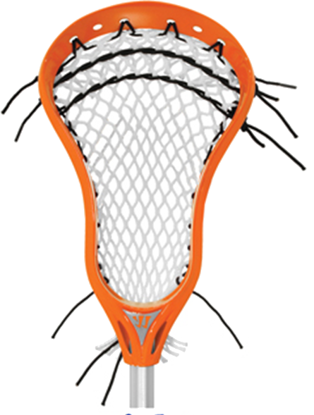
The Head of the Crosse
Scoop
Shooting Strings
Sidewall
Mesh
Ball Stop
Maximum of 2 inches in length,
1½ inches in width and ¼-inch in thickness.
Not Required
Neck
Throat
Only 1
Rule 1:6-8
Notes:
Ballstop

Slide 9
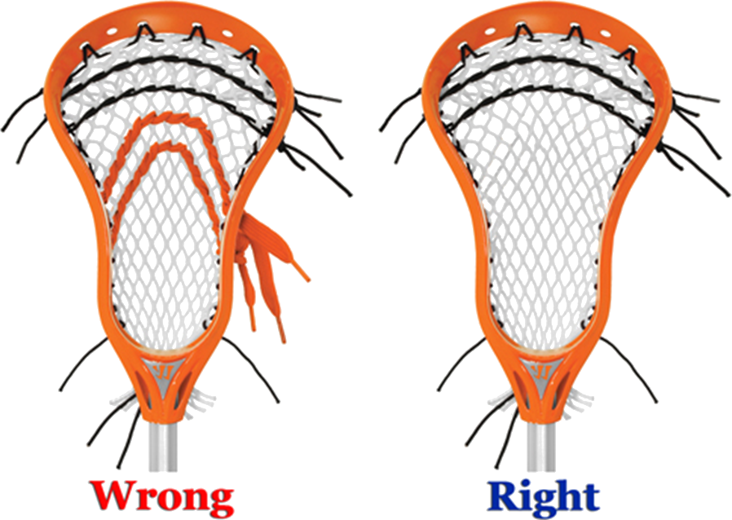
Shooting Strings & Sidewalls
Shooting strings must be located within 4” inches of the top of the crosse.
No more than one side wall string on each side is allowed.
2-minute NR
Rule 1-7-3
Notes:
Discuss the rationale for this change. Ball has become too difficult to dislodge, so what do defenders resort to: more reckless stick and body checking.

Slide 10
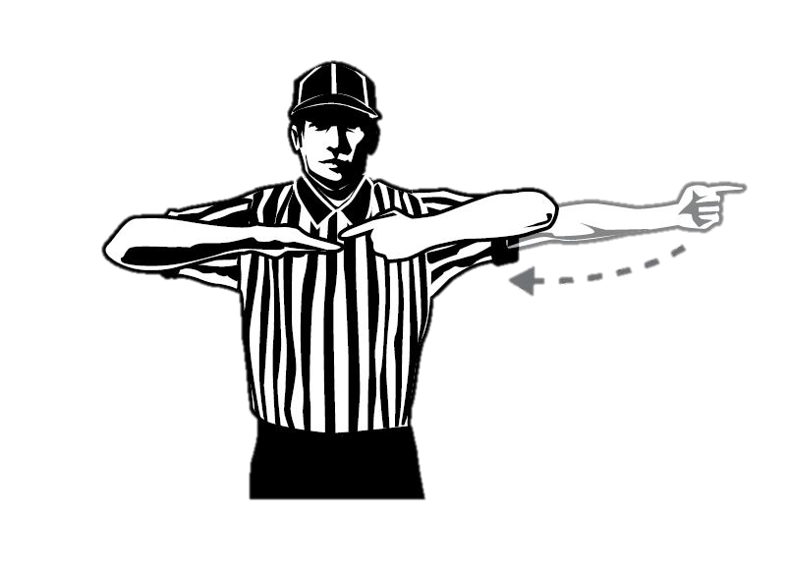
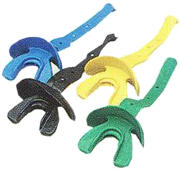
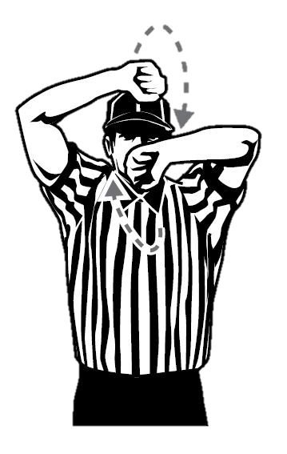
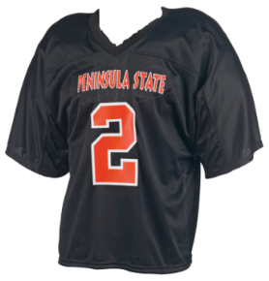
Illegal Equipment
Not wearing required or prohibited equipment: 1 minute NR (for all violations).
No mouthpiece: stop play, 30 second technical, unless official KNOWS it came out during play.
Improper uniforms: 1 technical foul for all violations.
Illegally equipped substitutes: sent off!
Rule 5:6, 6:5-x, 6:5-3
Notes:
If goalie breaks his crosse or loses or breaks any other required equipment, stop play immediately (allow shot in flight to conclude). Uniform violations NOT an issue in YOUTH.
Award possession as with inadvertent whistle.
USC for intentional lost equipment to stop play.
Goalie playing without crosse is a technical foul.
Once game starts no more uniform violations.

Slide 11
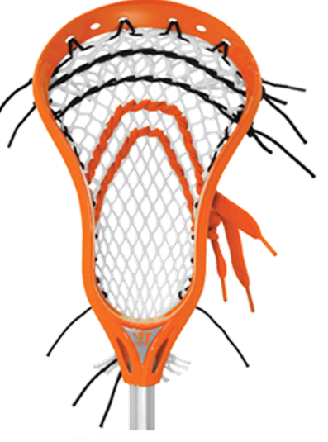
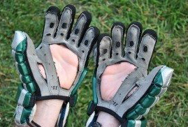
Illegal Equipment + Illegal Crosse
1 minute NR
2 minute NR
Rule 5:6 C
Notes:
Multiple instances of illegal or prohibited equipment are one violation
Always assess worst violation.
Altering crosse prior to a request for inspection is the exception.

Slide 12
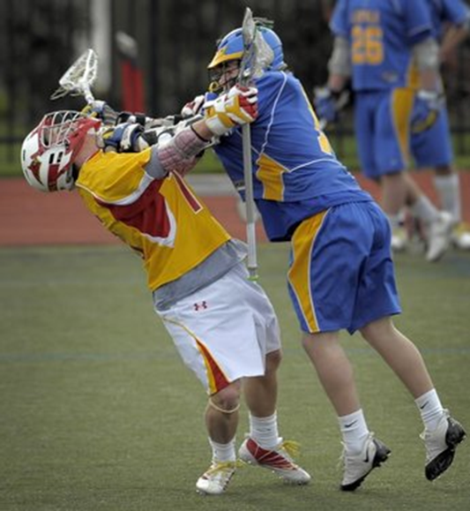
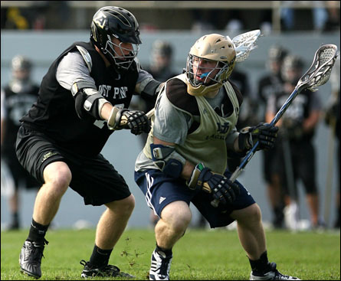
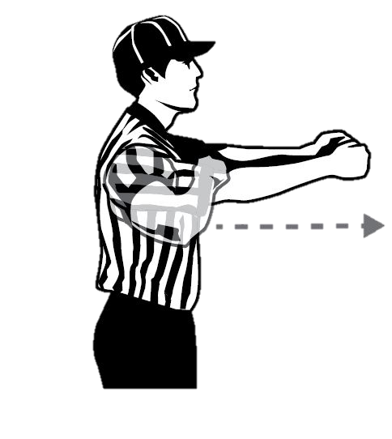
May not check with the part of the handle between his hands by thrusting away or holding it extended from the body.
Thrusting is viscous and deliberate.
Cross Check
Rule 5:2
Notes:
Rule 5:2
Thrusting, viscous and deliberate. Simply making contact with crosse in between hands is not enough.

Slide 14
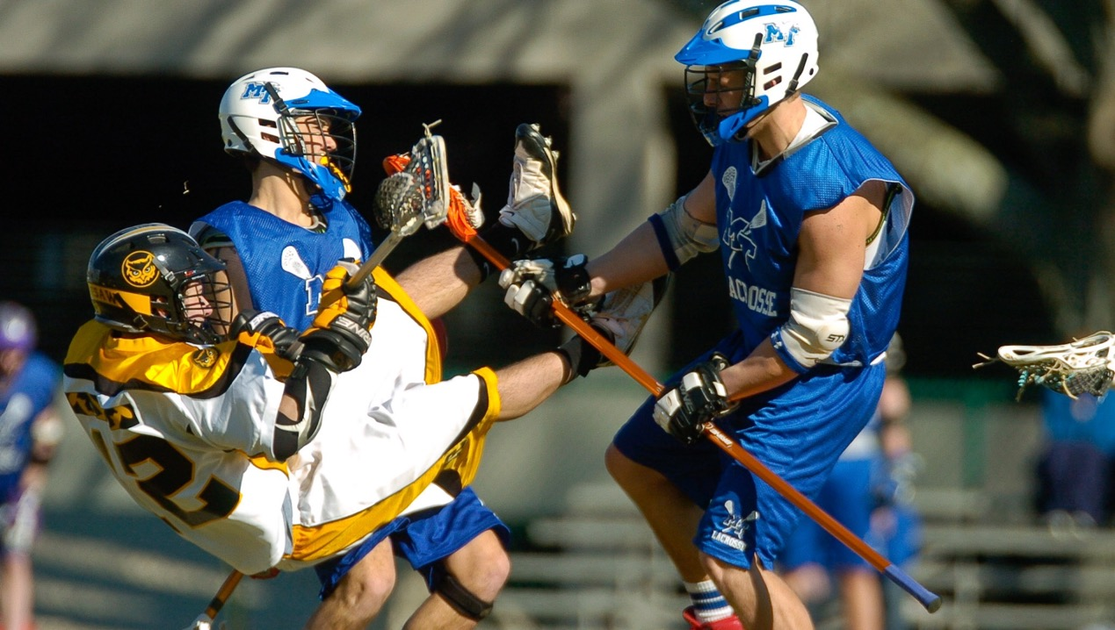
Notes:
But my hands were together.
You can see this play developing well before it happens!

Slide 15
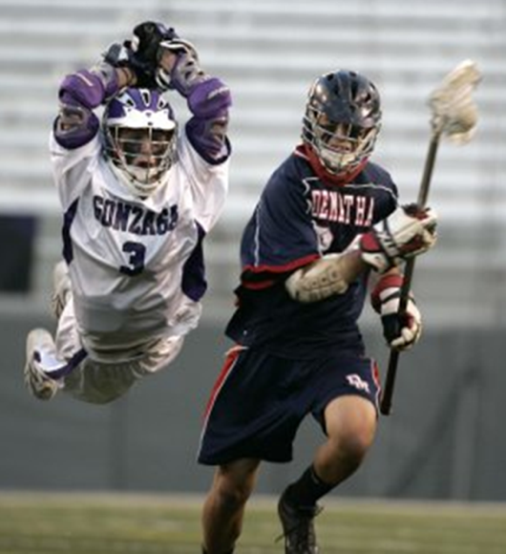
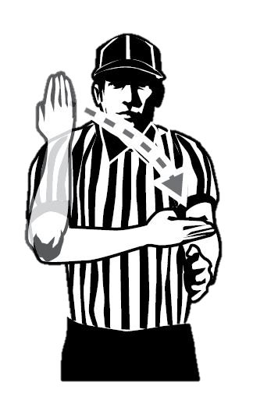
Swinging crosse at an opponent’s body or crosse with deliberate viciousness or reckless abandon
Striking player in the face, groin, neck, chest, back, or head.
Regardless of whether contact is made.
Slashing
Rule 5:7
Notes:
Unless used to deflect stick check.
Cannot deliberately beat on the free arm.
Not a slash if in an attempt to dislodge the ball and opponent uses part of his body (not neck or head) to protect his crosse and contact is made as a result.
Gloved hand is considered part of crosse, except when in contact with a line marking. Contact alone is not a slash, even to the head.

Slide 17
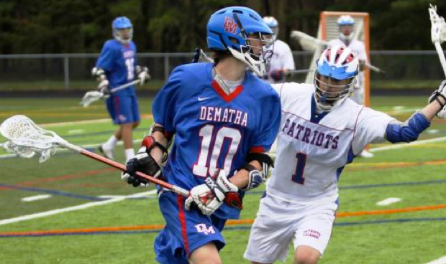
Notes:
One Handed Check in youth is a slash! Always.
High checks (above the shoulder) new emphasis in 2017.

Slide 18
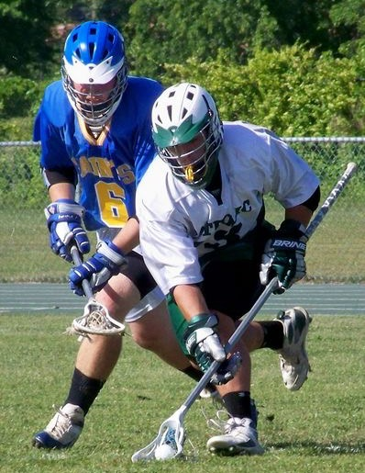
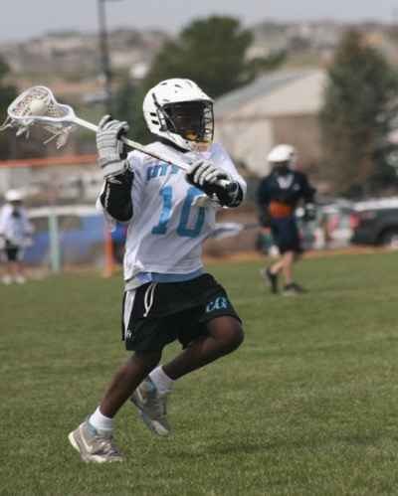
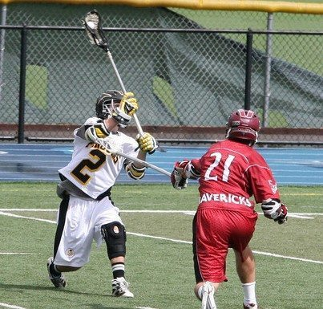
Scooping Loose Ball
Passing
Shooting
Slashing Exceptions
Rule 5:7 Art. 3
Notes:
Rule 5:8
Not a slash if contact is in the act of
Gloved hand touching the crosse is part of the crosse.

Slide 19
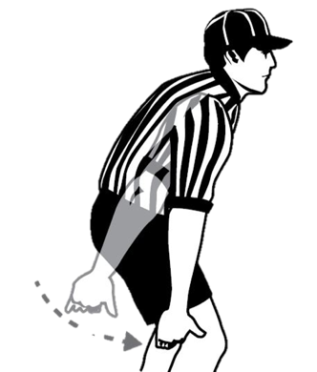
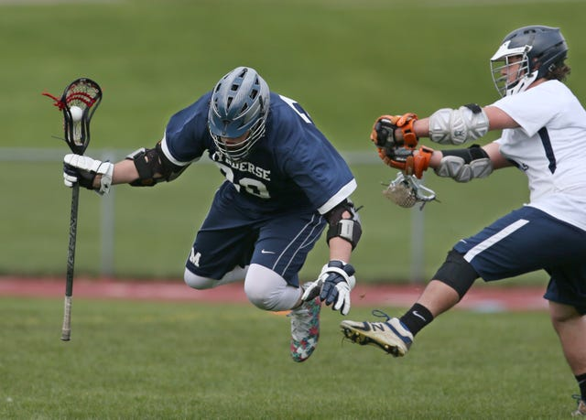
Obstructing an opponent at or below the waist with the crosse, hands, feet, arms by any positive primary action if the obstructing player is on his feet, or secondary action if not.
Tripping
Rule 5:8
Notes:
One of the most confusing rules in lacrosse. No one knows what positive primary or secondary action is.
Is it safety or at the goal on a fast break e.g. or is it TPOAD?

Slide 20
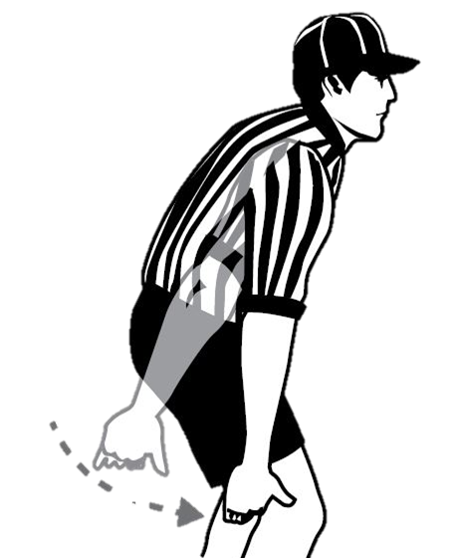
A legal check causing a player to fall over his own crosse.
Falling over the leg of a stationary defender.
Tripping over player’s own cross.
Trip over the cross of a player attempting to scoop a loose ball.
Tripping Exceptions
Rule 5:8
Notes:
Rule 5:8

Slide 21
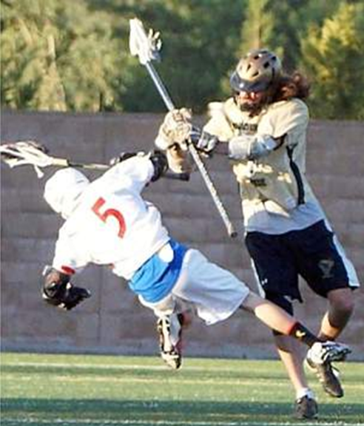
NOT within 5 yards of loose ball.
From behind, below the waist, or above the shoulders.
Only one hand on crosse.
Avoidable or late.
Opponent has any part of his body other than his feet on ground.
Illegal Body Check
Rule 5:3
Notes:
Ask what a legal body check requires. If the hit doesn’t meet those requirements it is illegal.
Rule 5:4
an emphasis placed on high body checks.
A two-handed defensive thrust that slides up into the head should be called an illegal body check.
Any body check that appears illegal due to the late jump, duck, or turn of the player about to be checked is not illegal. You MUST see the initial contact.

Slide 23
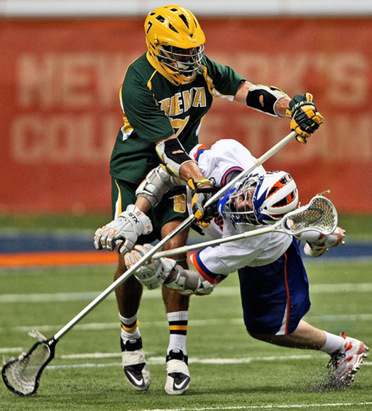
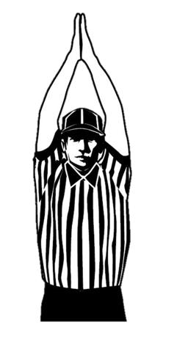
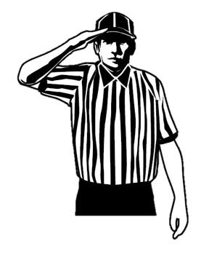
Player shall not initiate an excessive, violent or uncontrolled slash to the head/neck.
Can be called on or
A
B
2-3 Minute
Ejection
Checks Involving the Head & Neck
Rule 5:4
Notes:
This is an clarification of last years rule change. Why is this important? Reducing head injuries in high school sports!
In addition, the rule now prohibits an offensive player in possession of the ball from blocking an opponent with the head or initiating contact with the head.
Any body check that is initiated or follows through with the head or with the body or crosse to head.

Slide 24
Notes:
Title of the video asks is this intentional, regardless of intent this is a major foul. This is a lacrosse play therefore not targeting.

Slide 25
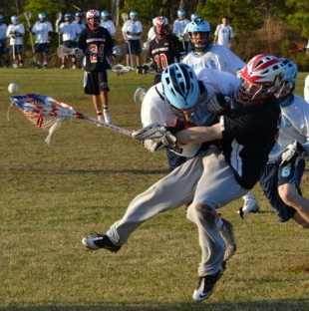
May not body-check:
from the blind side.
a player with head down playing a loose ball.
a player receiving buddy pass.
2-3 Minute
Ejection
Checking a Defenseless Player
Rule 5:4-5
Notes:
This is an expansion of the IBC rule. This is an clarification of last years rule change.
In addition, the rule now prohibits an offensive player in possession of the ball from blocking an opponent with the head or initiating contact with the head.

Slide 26
Notes:
Buddy pass

Slide 27
May not intentionally target the head & neck or a player in a defenseless position.
3 Minute
Ejection
Targeting
Rule 5:4-5
Notes:
This is an expansion of the IBC rule: a new rule building on last years rule change.
These plays are not lacrosse plays but are meant to injure an opponent with an intentional and violent act.

Slide 29
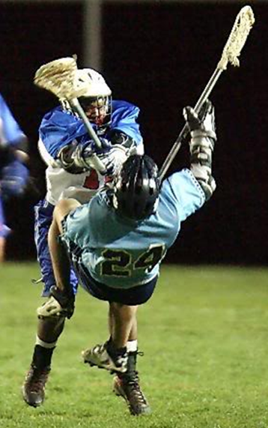
Excessively violent holding and pushing.
Avoidable or late.
Deliberate and excessively violent act with body or crosse.
No punching blows!
Deliberate & excessive contact with player setting screen.
MAY INCLUDE A LEGAL CHECK
Unnecessary Roughness
Rule 5:9
Notes:
Lacrosse is a skill game that allows occasional contact.
Why worry about this? Concussions

Slide 30
Notes:
Fogo crushed by wong

Slide 31
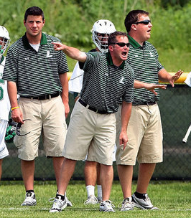
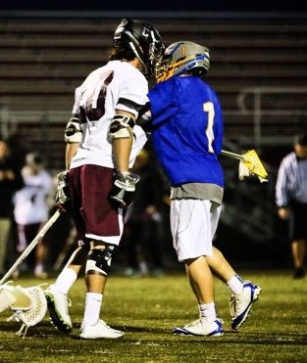
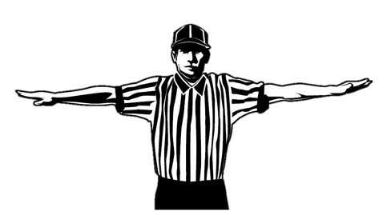
Arguing with or maligning the official.
Threatening, profane, or obscene language or gestures.
Taunting, calling undue attention to oneself.
Any other act considered USC by the officials.
F
1-3 Minute
Non-Releasable USC
Rule 5:10
Notes:
Not safety but sportsmanship. Language, tobacco, taunting.

Slide 32
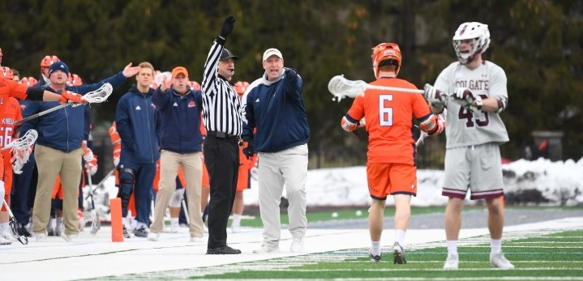
1-3 Minute Releasable USC
Coach Obstructing Play
Rule 5:10
Notes:
e. A coach who is on the field and obstructs play.
PENALTY: Items above are one- to three-minute, non-releasable penalties in all cases.
e. f. Repeatedly commit the same technical foul.
Rationale: Defines penalties for a coach obstructing play.

Slide 33
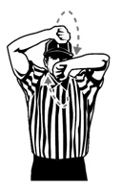
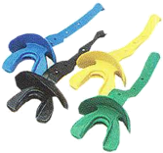
Repeatedly committing same technical foul.
Second time field player in crease playing as goalie
Deliberately failing to return immediately to the field while legally in the game.
Substitute deliberately failing to comply with the rules for entering the field of play.
1-3 Minute
Releasable USC
Rule 5:10

Slide 34
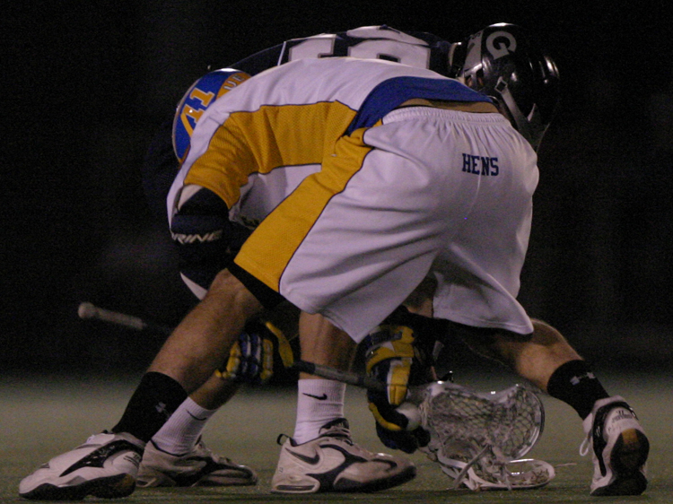
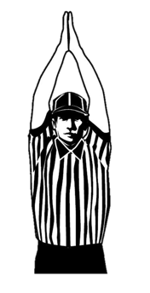
No player may deliberately grab the ball or opponent’s crosse with open hand or fingers.
1-3 Minute
Grabbing Ball on Faceoff
Rule 5:10 -d
Notes:
Rule 5-10 d. No player may deliberately grab the ball or opponent’s crosse with open hand or fingers. 1-3 minute USC NR.

Slide 36
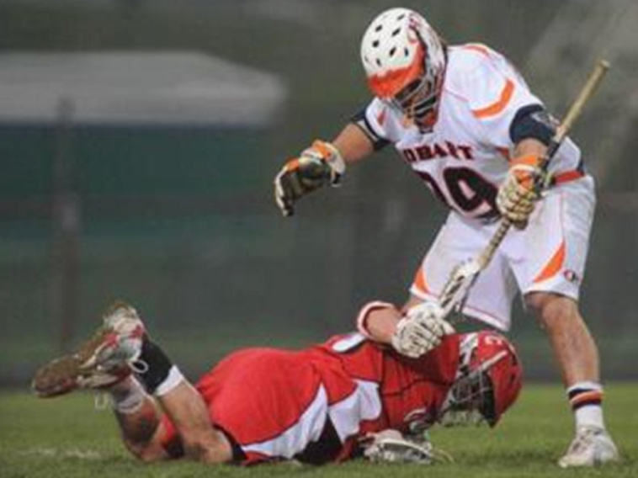
No player may deliberately grab the ball or opponent’s crosse with open hand or fingers on a faceoff.
1-3 Minute
Holding on Faceoff
Rule 5:10-d

Slide 37
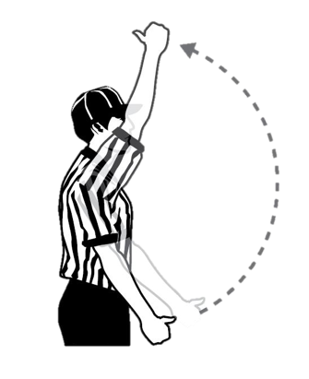
Player, substitute, coach or non-player may be ejected for:
Striking or attempting to strike anyone.
Leaving bench during a fight.
Tobacco.
Second NR USC.
Flagrant misconduct
Must leave premises. If unable, must remain in bench area.
Ejection
Rule 5:12, 7:12
Notes:
Rule 5: 10-11
Ejection Rule 7:12
Contact assignor immediately with details.
Ejection can occur after the game has ended!

Slide 38
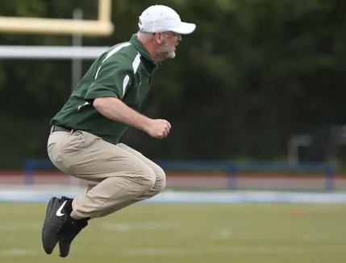
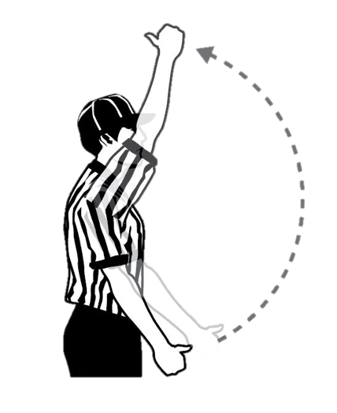
Ejection Penalty Time
Player = 3-minutes
Coach = 1-minute
Rule 5.12.1
Notes:
PENALTY:
Three-minute non-releasable for a player, substitute or non-playing team member or a one-minute non-releasable penalty for a coach and ejection for the remainder of the game. The ejected coach shall be removed from the premises (bench and field area). The ejected player, substitute or non-playing team member shall be removed from the premises if there is authorized school personnel present to supervise the ejected student. If no authorized school personnel is available, the student shall be confined to the bench area. The sponsoring authority is responsible for notifying the appropriate school of the ejection.
Rationale: Penalizes a coach for an ejectable penalty without severely penalizing the players.

Slide 39
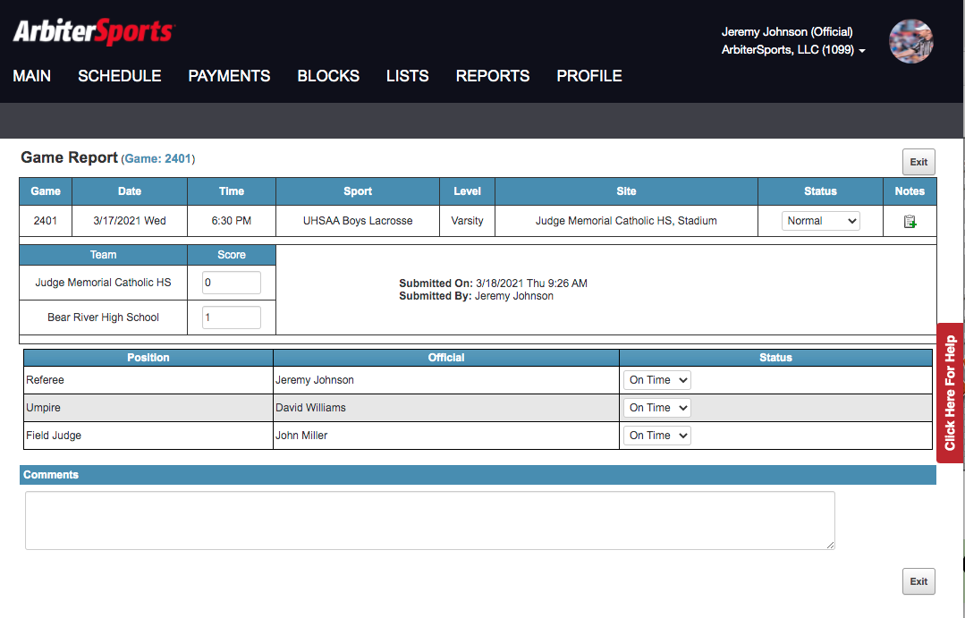
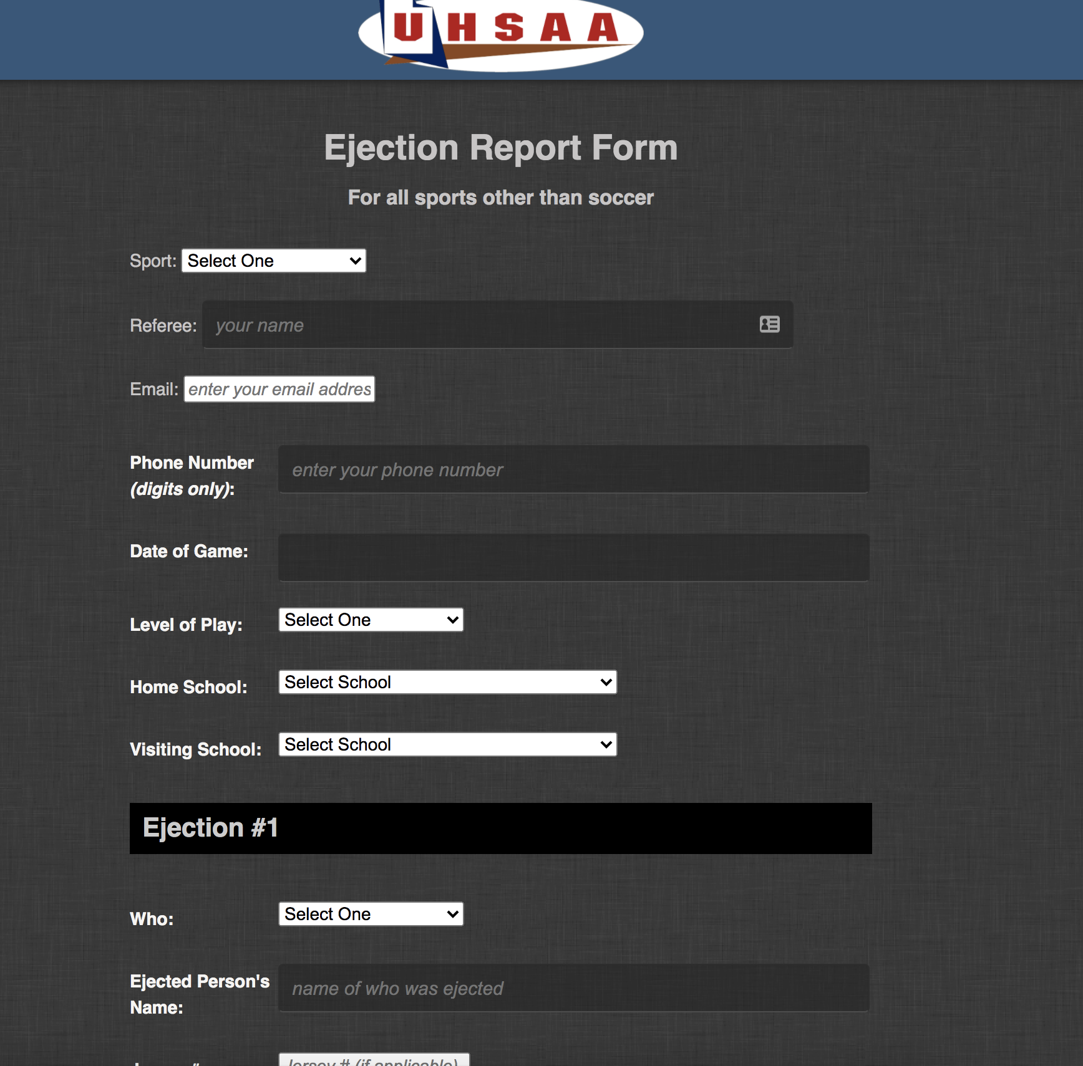
Any player or coach ejected for unsportsmanlike behavior or violent conduct will sit out the next game.
GAME REPORT
Ejection Report
https://uhsaa.org/ejections/sportreport.php
Disqualification and Ejection
Rule 5:12, 7:12
Notes:
Timekeepers’s responsibility to make sure non-players do not enter the game
CALL you assignor ASAP

Slide 40
Thanks!

